Slide 1
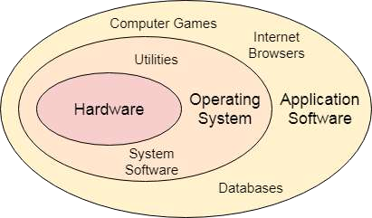
Operating System Definition and Function
In the Computer System (comprises of Hardware and software), Hardware can only understand machine code (in the form of 0 and 1) which doesn't make any sense to a naive user.
We need a system which can act as an intermediary and manage all the processes and resources present in the system.
An Operating System can be defined as an interface between user and hardware. It is responsible for the execution of all the processes (A process or running process refers to a set of instructions currently being processed by the computer processor), Resource Allocation, CPU management, File Management and many other tasks.
The purpose of an operating system is to provide an environment in which a user can execute programs in
convenient and efficient manner.

Slide 2
What does an Operating system do?
Process Management
Process Synchronization
Memory Management
CPU Scheduling
File Management
Security
Types of Operating Systems (OS)
An operating system is a well-organized collection of programs that manages the computer hardware. It is a type of system software that is responsible for the smooth functioning of the computer system.
Batch Operating System
In the 1970s, Batch processing was very popular. In this technique, similar types of jobs were batched together and executed in time. People were used to having a single computer which was called a mainframe.
In Batch operating system, access is given to more than one person; they submit their
respective jobs to the system for the execution.
The system put all of the jobs in a queue on the basis of first come first serve and then executes the jobs one by one. The users collect their respective output when all the jobs get executed.

Slide 3
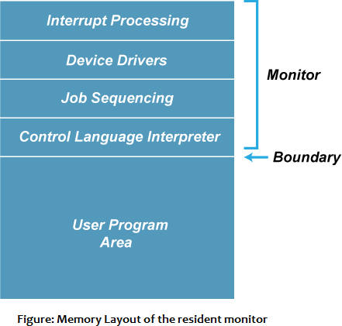
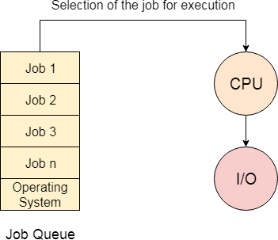
The purpose of this operating system was mainly to transfer control from one job to another as soon as the job was completed. It contained a small set of programs called the resident monitor that always resided in one part of the main memory. The remaining part is used for servicing jobs.
Advantages of Batch OS
The use of a resident monitor improves computer efficiency as it eliminates CPU time between two jobs.
Disadvantages of Batch OS
Starvation
Batch processing suffers from starvation.
For Example:
There are five jobs J1, J2, J3, J4, and J5, present in the batch. If the execution time of J1 is very high, then the other four jobs will never be executed, or they will have to wait for a very long time. Hence the other processes get starved.
Not Interactive
Batch Processing is not suitable for jobs that are dependent on the user's input. If a job requires the input of two numbers from the
console, then it will never get it in the batch processing scenario since the user is not present at the time of execution.

Slide 4
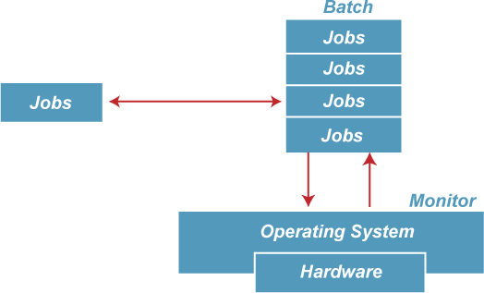

Slide 5
Multiprogramming Operating System
Multiprogramming is an extension to batch processing where the CPU is always kept busy.
Each process needs two types of system time: CPU time and IO time.
In a multiprogramming environment, when a process does its I/O, The CPU can start the execution of other processes. Therefore, multiprogramming improves the efficiency of the system.

Slide 6
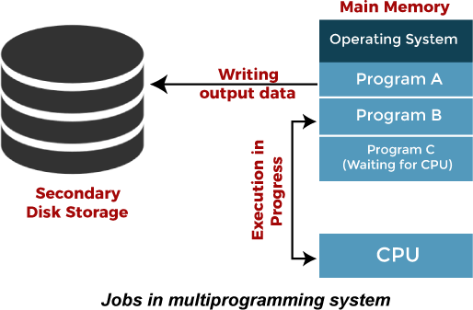
Advantages of Multiprogramming OS
Throughput (Throughput is a measure of how many units of information a system can process in a given amount of time) of the system is increased as the CPU always had one program to execute.
Response time (The difference between the arrival time and the time at which the
process first gets the CPU is called Response Time) can also be reduced.
Disadvantages of Multiprogramming OS
Multiprogramming systems provide an environment in which various systems resources are used efficiently, but they do not provide any user interaction with the computer system.

Slide 7
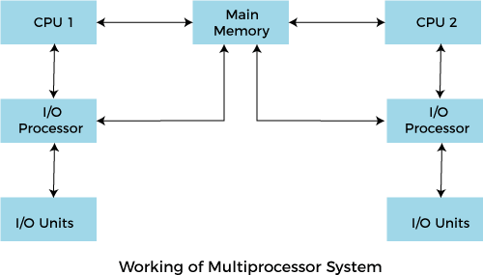
Multiprocessing Operating System
In Multiprocessing, Parallel computing is achieved. There are more than one processors present in the system which can execute more than one process at the same time. This will increase the throughput of the system.

Slide 8
Advantages of Multiprocessing operating system:
Increased reliability: Due to the multiprocessing system, processing tasks can be distributed among several processors. This increases reliability as if one processor fails, the task can be given to another processor for completion.
Increased throughput: As several processors increase, more work can be done in less time.
Disadvantages of Multiprocessing operating System
Multiprocessing operating system is more complex and sophisticated as it takes care
of multiple CPUs simultaneously.

Slide 9
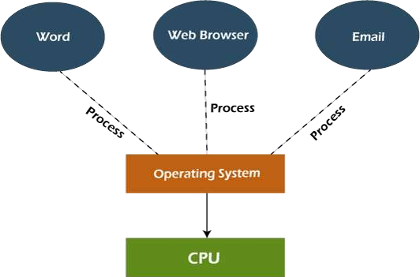
Multitasking Operating System
The multitasking operating system is a logical extension of a multiprogramming system that enables multiple programs simultaneously. It allows a user to perform more than one computer task at the same time.
Advantages of Multitasking operating system
This operating system is more suited to supporting multiple users simultaneously.
The multitasking operating systems have well-defined memory management.
Disadvantages of Multitasking operating system
The multiple processors are busier at the same time to complete any task in a
multitasking environment, so the CPU generates more heat.

Slide 10
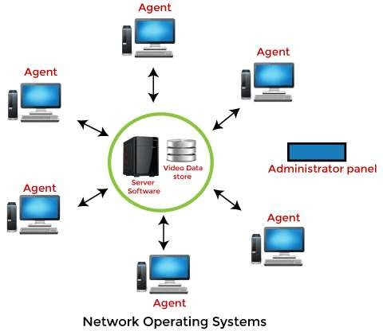
Network Operating System
An Operating system, which includes software and associated protocols to communicate with other computers via a network conveniently and cost-effectively, is called Network Operating System.

Slide 11
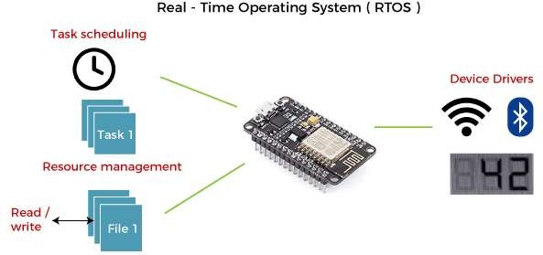
Advantages of Network Operating System
In this type of operating system, network traffic reduces due to the division between clients and the server.
This type of system is less expensive to set up and maintain.
Disadvantages of Network Operating System
In this type of operating system, the failure of any node in a system affects the whole system.
Security and performance are important issues. So trained network administrators are required
for network administration.
Real Time Operating System
In Real-Time Systems, each job carries a certain deadline within which the job is supposed to be completed, otherwise, the huge loss will be there, or even if the result is produced, it will be completely useless.

Slide 12
The Application of a Real-Time system exists in the case of military applications, if you want to drop a missile, then the
missile is supposed to be dropped with a certain precision.
Advantages of Real-time operating system:
Easy to layout, develop and execute real-time applications under the real-time operating system.
In a Real-time operating system, the maximum utilization of devices and systems.
Disadvantages of Real-time operating system:
Real-time operating systems are very costly to develop.
Real-time operating systems are very complex and can consume critical CPU cycles.

Slide 13
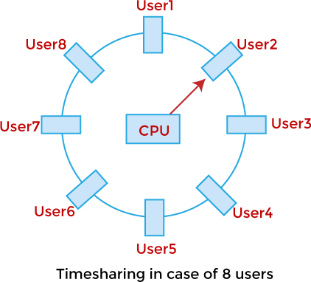
Time-Sharing Operating System
In the Time Sharing operating system, computer resources are allocated in a time-dependent fashion to several programs simultaneously. Thus it helps to provide a large number of user's direct access to the main computer. It is a logical extension of multiprogramming. In time-sharing, the CPU is switched among multiple programs given by different users on a scheduled basis.
A time-sharing operating system allows many users to be served simultaneously, so sophisticated CPU scheduling schemes and Input/output management are required.
Time-sharing operating systems are very difficult and expensive to build.

Slide 14
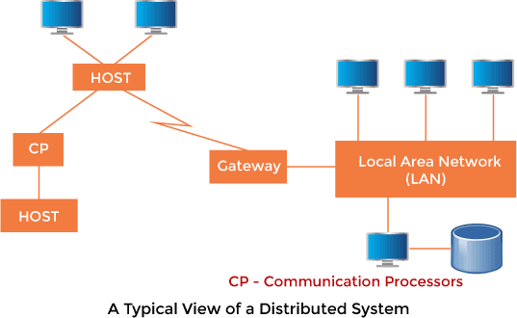
Advantages of Time Sharing Operating System
The time-sharing
resources.
This system reduces CPU idle and response time.
Disadvantages of Time Sharing Operating System
Data transmission rates are very high in comparison to other methods.
Security and integrity of user programs loaded in memory and data need to be
maintained as many users access the system at the same time.
Distributed Operating System
The Distributed Operating system is not installed on a single machine, it is divided into parts, and these parts are loaded on different machines. A part of the distributed Operating system is installed on each machine to make their communication possible. Distributed Operating systems are much more complex, large, and sophisticated than Network operating systems because they also have to take care of varying networking protocols.
operating system provides effective utilization and sharing of

Slide 15
Advantages of Distributed Operating System
The distributed operating system provides sharing of resources.
This type of system is fault-tolerant (process which enables an OS to respond to a failure in
H/W or S/W).
Disadvantages of Distributed Operating System
Protocol overhead can dominate computation cost.
Process Management in OS
A Program does nothing unless its instructions are executed by a CPU. A program in execution is called a process. In order to accomplish its task, process needs the computer resources.
There may exist more than one process in the system which may require the same resource at the same time. Therefore, the operating system has to manage all the processes and the resources in a convenient and efficient way.
Some resources may need to be executed by one process at one time to maintain the consistency
otherwise the system can become inconsistent and deadlock may occur.
The operating system is responsible for the following activities in connection with Process
Management
Scheduling processes and threads on the CPUs. Creating and deleting both user and system processes. Suspending and resuming processes.
Providing mechanisms for process synchronization.
Providing mechanisms for process communication.

Slide 16
Attributes of a process
The Attributes of the process are used by the Operating System to create the process control block (PCB) for each of
them. This is also called context of the process. Attributes which are stored in the PCB are described below.
Process ID
When a process is created, a unique id is assigned to the process which is used for unique identification of the
process in the system.
Program counter
A program counter stores the address of the last instruction of the process on which the process was suspended.
The CPU uses this address when the execution of this process is resumed.
Process State
The Process, from its creation to the completion, goes through various states which are new, ready, running and
waiting. We will discuss about them later in detail.
Priority
Every process has its own priority. The process with the highest priority among the processes gets the CPU first. This
is also stored on the process control block.
General Purpose Registers
Every process has its own set of registers which are used to hold the data which is generated during the execution of
the process.
List of open files
During the Execution, Every process uses some files which need to be present in the main memory. OS also
maintains a list of open files in the PCB.
List of open devices
OS also maintain the list of all open devices which are used during the execution of the process.

Slide 17
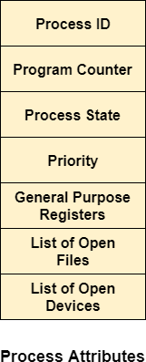
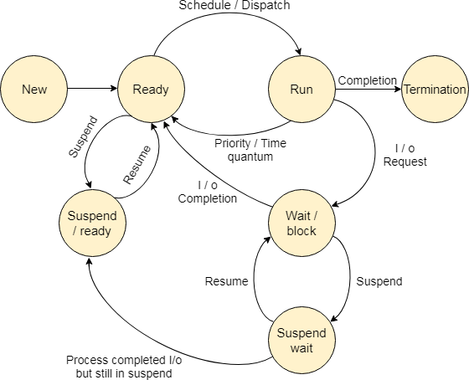
Process States
State Diagram

Slide 18
The process, from its creation to completion, passes through various states. The minimum number of states
is five.
The names of the states are not standardized although the process may be in one of the following states during execution.
New
A program which is going to be picked up by the OS into the main memory is called a new process.
Ready
Whenever a process is created, it directly enters in the ready state, in which, it waits for the CPU to be assigned. The OS picks the new processes from the secondary memory and put all of them in the main memory.
The processes which are ready for the execution and reside in the main memory are called ready state processes. There can be
many processes present in the ready state.
Running
One of the processes from the ready state will be chosen by the OS depending upon the scheduling algorithm. Hence, if we have only one CPU in our system, the number of running processes for a particular time will always be one. If we have n processors in the system then we can have n processes running simultaneously.
Block or wait
From the Running state, a process can make the transition to the block or wait state depending upon the scheduling algorithm or
the intrinsic behavior of the process.
When a process waits for a certain resource to be assigned or for the input from the user then the OS move this process to the block or wait state and assigns the CPU to the other processes.

Slide 19
Completion or termination
When a process finishes its execution, it comes in the termination state. All the context of the process (Process Control Block) will also be deleted and the process will be terminated by the Operating system.
Suspend ready
A process in the ready state, which is moved to secondary memory from the main memory due to lack of the resources (mainly primary memory) is called in the suspend ready state.
If the main memory is full and a higher priority process comes for the execution then the OS have to make the room for the process in the main memory by throwing the lower priority process out into the secondary memory. The suspend ready processes remain in the secondary memory until the main memory gets available.
Suspend wait
Instead of removing the process from the ready queue, it's better to remove the blocked process which is waiting for some resources in the main memory. Since it is already waiting for some resource to get available hence it is better if it waits in the secondary memory and make room for the higher priority process. These processes complete their execution once the main memory gets available and their wait is finished.

Slide 20
Operations on the Process
Creation
Once the process is created, it will be ready and come into the ready queue (main
memory) and will be ready for the execution.
Scheduling
Out of the many processes present in the ready queue, the Operating system chooses one process and start executing it. Selecting the process which is to be executed next, is known as scheduling.
Execution
Once the process is scheduled for the execution, the processor starts executing it. Process may come to the blocked or wait state during the execution then in that case the processor starts executing the other processes.
Deletion/killing
Once the purpose of the process gets over then the OS will kill the process. The Context of the process (PCB) will be deleted and the process gets terminated by the Operating system.

Slide 21
Process Scheduling in OS (Operating System)
Operating system uses various schedulers for the process scheduling described below.
Long term scheduler
Long term scheduler is also known as job scheduler. It chooses the processes from the pool (secondary memory) and keeps them in the ready queue maintained in the primary memory.
Long Term scheduler mainly controls the degree of Multiprogramming. The purpose of long term scheduler is to choose a perfect mix of IO bound and CPU bound processes among the jobs present in the pool.
If the job scheduler chooses more IO bound processes then all of the jobs may reside in the blocked state all the time and the CPU will remain idle most of the time. This will reduce the degree of Multiprogramming. Therefore, the Job of long term scheduler is very critical and may affect the system for a very long time.
Short term scheduler
Short term scheduler is also known as CPU scheduler. It selects one of the Jobs from the ready queue and dispatch to the CPU for the execution.
A scheduling algorithm is used to select which job is going to be dispatched for the execution. The Job of the short term scheduler can be very critical in the sense that if it selects job whose CPU burst time is very high then all the jobs after that, will have to wait in the ready queue for a very long time.
This problem is called starvation which may arise if the short term scheduler makes some
mistakes while selecting the job.

Slide 22
3. Medium term scheduler
Medium term scheduler takes care of the swapped out processes. If the running state processes needs some IO time for the completion then there is a need to change its state from running to waiting.
Medium term scheduler is used for this purpose. It removes the process from the running state to make room for the other processes. Such processes are the swapped out processes and this procedure is called swapping. The medium term scheduler is responsible for suspending and resuming the processes.
It reduces the degree of multiprogramming. The swapping is necessary to have a perfect mix of processes in the ready queue.
Process Queues
The Operating system manages various types of queues for each of the process states. The PCB related to the process is also stored in the queue of the same state. If the Process is moved from one state to another state then its PCB is also unlinked from the corresponding queue and added to the other state queue in which the transition is made.

Slide 23
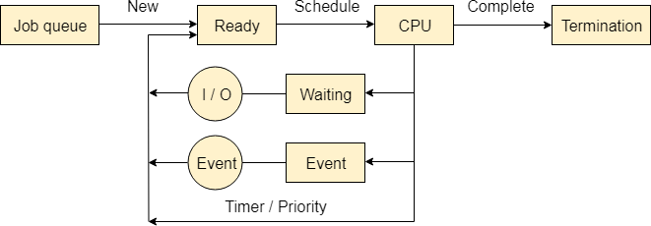
There are the following queues maintained by the Operating system.
Job Queue
In starting, all the processes get stored in the job queue. It is maintained in the secondary memory. The long term scheduler (Job scheduler) picks some of the jobs and put them in the primary memory.
Ready Queue
Ready queue is maintained in primary memory. The short term scheduler picks the job from the ready queue and dispatch to the CPU for the execution.
Waiting Queue
When the process needs some IO operation in order to complete its execution, OS changes the state of the process from running to waiting. The context (PCB) associated with the process gets stored on the waiting queue which will be used by the Processor when the process finishes the IO.

Slide 24
Various Times related to the Process
Arrival Time
The time at which the process enters into the ready queue is called the arrival time.
Burst Time
The total amount of time required by the CPU to execute the whole process is called the Burst Time. This does not include the waiting time. It is confusing to calculate the execution time for a process even before executing it hence the scheduling problems based on the burst time cannot be implemented in reality.
Completion Time
The Time at which the process enters into the completion state or the time at which the
process completes its execution, is called completion time.
Turnaround time
The total amount of time spent by the process from its arrival to its completion, is called Turnaround time.
Waiting Time
The Total amount of time for which the process waits for the CPU to be assigned is called
waiting time.
Response Time
The difference between the arrival time and the time at which the process first gets the
CPU is called Response Time.

Slide 25
CPU Scheduling
In the uniprogrammming systems like MS DOS, when a process waits for any I/O operation to be done, the CPU remains idol. This is an overhead since it wastes the time and causes the problem of starvation. However, In Multiprogramming systems, the CPU doesn't remain idle during the waiting time of the Process and it starts executing other processes. Operating System has to define which process the CPU will be given.
In Multiprogramming systems, the Operating system schedules the processes on the CPU to have the maximum utilization of it and this procedure is called CPU scheduling. The Operating System uses various scheduling algorithm to schedule the processes.
This is a task of the short term scheduler to schedule the CPU for the number of processes present in the Job Pool. Whenever the running process requests some IO operation then the short term scheduler saves the current context of the process (also called PCB) and changes its state from running to waiting. During the time, process is in waiting state; the Short term scheduler picks another process from the ready queue and assigns the CPU to this process. This procedure is called context switching.
What is saved in the Process Control Block?
The Operating system maintains a process control block during the lifetime of the process. The Process control block is deleted when the process is terminated or killed. There is the following information which is saved in the process control block and is changing with the state of the process.

Slide 26
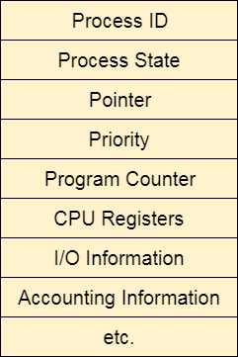
Why do we need Scheduling?
In Multiprogramming, if the long term scheduler picks more I/O bound processes then most of the time, the CPU remains idol. The task of Operating system is to optimize the utilization of resources.
If most of the running processes change their state from running to waiting then there may always be a possibility of deadlock in the system. Hence to reduce this overhead, the OS needs to schedule the jobs to get the optimal utilization of CPU and to avoid the possibility to deadlock.

Slide 27
Scheduling Algorithms in OS (Operating System)
There are various algorithms which are used by the Operating System to schedule the processes on the processor in an efficient way.
The Purpose of a Scheduling algorithm
Maximum CPU utilization
Fare allocation of CPU
Maximum throughput
Minimum turnaround time
Minimum waiting time
Minimum response time
There are the following algorithms which can be used to schedule the jobs.
First Come First Serve
It is the simplest algorithm to implement. The process with the minimal arrival time will get the CPU first. The lesser the arrival time, the sooner will the process gets the CPU. It is the non-preemptive type of scheduling.
Round Robin
In the Round Robin scheduling algorithm, the OS defines a time quantum (slice). All the processes will get executed in the cyclic way. Each of the process will get the CPU for a small amount of time (called time quantum) and then get back to the ready queue to wait for its next turn. It is a preemptive type of scheduling.

Slide 28
Shortest Job First
The job with the shortest burst time will get the CPU first. The lesser the burst time, the
sooner will the process get the CPU. It is the non-preemptive type of scheduling.
Shortest remaining time first
It is the preemptive form of SJF. In this algorithm, the OS schedules the Job according to the remaining time of the execution.
Priority based scheduling
In this algorithm, the priority will be assigned to each of the processes. The higher the priority, the sooner will the process get the CPU. If the priority of the two processes is same then they will be scheduled according to their arrival time.
Highest Response Ratio Next
In this scheduling Algorithm, the process with highest response ratio will be scheduled next. This reduces the starvation in the system.

Slide 29
First Come First Serve CPU Process Scheduling in Operating Systems
In this tutorial, we are going to learn an important concept in CPU Process Scheduling Algorithms. The important concept name is First Come First Serve. This is the basic algorithm which every student must learn to understand all the basics of CPU Process Scheduling Algorithms.
First Come First Serve paves the way for understanding of other algorithms. This algorithm may have many disadvantages. But these disadvantages created very new and efficient algorithms. So, it is our responsibility to learn about First Come First Serve CPU Process Scheduling Algorithms.
Important Abbreviations
CPU - - - > Central Processing Unit FCFS - - - > First Come First Serve AT - - - > Arrival Time
BT - - - > Burst Time
WT - - - > Waiting Time
TAT - - - > Turn Around Time CT - - - > Completion Time FIFO - - - > First In First Out First Come First Serve
First Come First Serve CPU Scheduling Algorithm shortly known as FCFS is the first algorithm of CPU Process Scheduling Algorithm. In First Come First Serve Algorithm what we do is to allow the process to execute in linear manner.
This means that whichever process enters process enters the ready queue first is executed first. This
shows that First Come First Serve Algorithm follows First In First Out (FIFO) principle.

Slide 30
The First Come First Serve Algorithm can be executed in Pre Emptive and Non Pre Emptive manner. Before, going into examples, let us understand what is Pre Emptive and Non Pre Emptive Approach in CPU Process Scheduling.
Pre Emptive Approach
In this instance of Pre Emptive Process Scheduling, the OS allots the resources to a Process for a predetermined period of time. The process transitions from running state to ready state or from waiting state to ready state during resource allocation. This switching happens because the CPU may assign other processes precedence and substitute the currently active process for the higher priority process.
Non Pre Emptive Approach
In this case of Non Pre Emptive Process Scheduling, the resource cannot be withdrawn from a process before the process has finished running. When a running process finishes and transitions to the waiting state, resources are switched.
Convoy Effect In First Come First Serve (FCFS )
Convoy Effect is a phenomenon which occurs in the Scheduling Algorithm named First Come First Serve (FCFS). The First Come First Serve Scheduling Algorithm occurs in a way of non preemptive way.
The Non preemptive way means that if a process or job is started execution, then the operating system must complete its process or job. Until, the process or job is zero the new or next process or job does not start its execution. The definition of Non Preemptive Scheduling in terms of Operating System means that the Central Processing Unit (CPU) will be completely dedicated till the end of the process or job started first and the new process or job is executed only after finishing of the older process or job.
There may be a few cases, which might cause the Central Processing Unit (CPU) to allot a too much time. This is because in the First Come First Serve Scheduling Algorithm Non Preemptive Approach, the Processes or the jobs are chosen in serial order. Due, to this shorter jobs or processes behind the larger processes or jobs takes too much time to complete its execution. Due, to this the Waiting Time, Turn Around Time, Completion Time is very high.

Slide 31
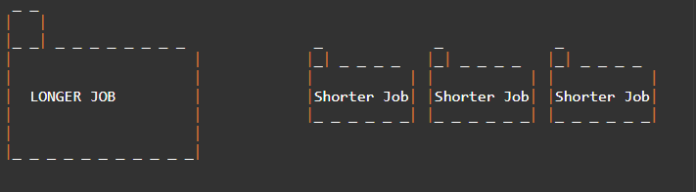
So, here as the first process is large or completion time is too high, then this Convoy
effect in the First Come First Serve Algorithm is occurred.
Let us assume that Longer Job takes infinite time to complete. Then, the remaining processes have to wait for the same infinite time. Due to this Convoy Effect created by the Longer Job the Starvation of the waiting processes increases very rapidly. This is the biggest disadvantage of FCFS CPU Process Scheduling.
Characteristics of FCFS CPU Process Scheduling
The characteristics of FCFS CPU Process Scheduling are:
Implementation is simple.
Does not cause any causalities while using
It adopts a non pre emptive and pre emptive strategy.
It runs each procedure in the order that they are received.
Arrival time is used as a selection criterion for procedures.

Slide 32
Advantages of FCFS CPU Process Scheduling
The advantages of FCFS CPU Process Scheduling are:
In order to allocate processes, it uses the First In First Out queue.
The FCFS CPU Scheduling Process is straight forward and easy to implement.
In the FCFS situation pre emptive scheduling, there is no chance of process starving.
As there is no consideration of process priority, it is an equitable algorithm.
Disadvantages of FCFS CPU Process Scheduling
The disadvantages of FCFS CPU Process Scheduling are:
FCFS CPU Scheduling Algorithm has Long Waiting Time
FCFS CPU Scheduling favors CPU over Input or Output operations
In FCFS there is a chance of occurrence of Convoy Effect
Because FCFS is so straight forward, it often isn't very effective. Extended waiting periods go hand in hand with this. All other orders are left idle if the CPU is busy processing one time-consuming order.

Slide 33
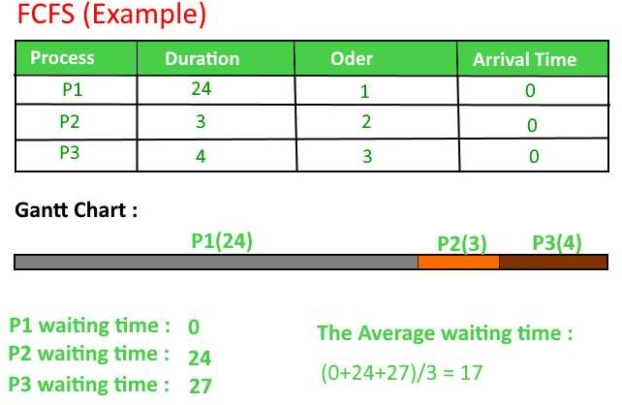

Slide 34
Example
Suppose we have a set of five processes whose arrival time and burst time are given. We have to schedule the processes using FCFS
scheduling and calculate the average waiting time.
Solution
Lets's handle this process scheduling using FCFS. To understand it better, look at the figure below:
Process | Burst Time | Arrival Time
P1 | 6 | 2
P2 | 2 | 5
P3 | 8 | 1
P4 | 3 | 0
P5 | 4 | 4

Slide 35
The process will begin with P4 which has least arrival time 0
Step No 1
0
P4
waiting queue
Process Order

Slide 36
Step No 2
At Time = 1, P3 arrives. So P3 will be kept in waiting queue
1 time
P3
waiting queue
Process Order
P4

Slide 37
Step No 3
At Time = 2, P1 arrives which is kept in the queue as well
2 time
P3 | P1
waiting queue
Process Order
P4

Slide 38
At Time = 3, P4 process completes its execution
Step No 4
3 time
P3 | P1
waiting queue
Process Order
P4

Slide 39
Step No 5
At Time = 4, P3, which is first in the waiting queue starts execution
4 time
P1 | P5
waiting queue
Process Order
P4 | P3

Slide 40
At Time = 5, P2 arrives and it is kept in waiting queue
Step No 6
5 time
P1 | P5 | P2
waiting queue
Process Order
P4 | P3

Slide 41
At Time = 13, P3 completes its execution
Step No 7
13
time
P1 | P5 | P2
waiting queue
Process Order
P4 | P3

Slide 42
At Time = 19, P1 starts execution. Its burst time was 6. Execution
completed at interval 19
Step No 8
19 time
 | P5 | P2
waiting queue
Process Order
P4 | P3 | P1

Slide 43
At Time = 19, P5 starts execution. Burst time was 4 and execution
completed at interval 23
Step No 9
23 time
 |  | P2
waiting queue
Process Order
P4 | P3 | P1 | P5

Slide 44
At Time = 23, P2 starts execution. Burst time was 2 and execution
completed at interval 25
Step No 10
25 time
waiting queue
Process Order
P4 | P3 | P1 | P5 | P2

Slide 45

Problems in the First Come First Serve CPU Scheduling Algorithm
Example
S. No
Process ID
Process Name Arrival Time Burst Time
_ _ _ _ _ _ _ _ _ _ _ _ _ _ _ _ _ _ _ _ _ _ _ _ _ _ _ _ _ _
1 | P 1 | A | 0 | 9
2 | P 2 | B | 1 | 3
3 | P 3 | C | 1 | 2
4 | P 4 | D | 1 | 4
5 | P 5 | E | 2 | 3
6 | P 6 | F | 3 | 2
Non Pre Emptive Approach
Now, let us solve this problem with the help of the Scheduling Algorithm named First
Come First Serve in a Non Preemptive Approach.
Gantt chart for the above Example 1 is:
Turn Around Time = Completion Time - Arrival Time
Waiting Time = Turn Around Time - Burst Time

Slide 46
Solution to the Above Question Example 1
The Average Completion Time is:
Average CT = ( 9 + 12 + 14 + 18 + 21 + 23 ) / 6
Average CT = 97 / 6 Average CT = 16.16667
The Average Waiting Time is:
Average WT = ( 0 + 8 + 11 + 13 + 16 + 18 ) /6
Average WT = 66 / 6 Average WT = 11
The Average Turn Around Time is:
Average TAT = ( 9 + 11 + 13 + 17 + 19 +20 ) / 6
Average TAT = 89 / 6 Average TAT = 14.83334
This is how the FCFS is solved in Non Pre Emptive Approach.
Now, let us understand how they can be solved in Pre Emptive Approach
S. No | Process ID | Arrival Time | Burst Time | Completio n Time | Turn Around Time | Waiting Time
1 | P 1 | A | 0 | 9 | 9 | 9 | 0
2 | P 2 | B | 1 | 3 | 12 | 11 | 8
3 | P 3 | C | 1 | 2 | 14 | 13 | 11
4 | P 4 | D | 1 | 4 | 18 | 17 | 13
5 | P 5 | E | 2 | 3 | 21 | 19 | 16
6 | P 6 | F | 3 | 2 | 23 | 20 | 18

Slide 47
Pre Emptive Approach
Now, let us solve this problem with the help of the Scheduling Algorithm named First Come First Serve in a Pre Emptive Approach.
In Pre Emptive Approach we search for the best process which is available
Gantt chart for the above Example 1 is:
S. No | Process ID | Arrival Time | Burst Time | Completio n Time | Turn Around Time | Waiting Time
1 | P 1 | A | 0 | 9 | 23 | 23 | 14
2 | P 2 | B | 1 | 3 | 8 | 7 | 4
3 | P 3 | C | 1 | 2 | 3 | 2 | 0
4 | P 4 | D | 1 | 4 | 15 | 14 | 10
5 | P 5 | E | 2 | 3 | 11 | 9 | 7
6 | P 6 | F | 3 | 2 | 5 | 2 | 0

Slide 48
FCFS with Overhead
In the above Examples, we are assuming that all the processes are the CPU bound processes only. We were also neglecting the context switching time.
However if the time taken by the scheduler in context switching is considered then the average waiting time of the system will be increased which also affects the efficiency of the system.
Context Switching is always an overhead. The Following Example describe the efficiency will be affected if the context switching time is considered in the system.
Example
In the following Example, we are considering five processes P1, P2, P3, P4, P5 and P6.
Their arrival time and Burst time are given below.
Process ID | Arrival Time | Burst Time
1 | 0 | 3
2 | 1 | 2
3 | 2 | 1
4 | 3 | 4
5 | 4 | 5
6 | 5 | 2

Slide 49
If the context switching time of the system is 1 unit then the Gantt chart of the system
will be prepared as follows.
Given δ=1 unit;
The system will take extra 1 unit of time (overhead) after the execution of every
process to schedule the next process.

Slide 50
Shortest Job First (SJF) Scheduling
Till now, we were scheduling the processes according to their arrival time (in FCFS scheduling). However, SJF scheduling algorithm, schedules the processes according to their burst time.
In SJF scheduling, the process with the lowest burst time, among the list of available processes in the ready queue, is going to be scheduled next.
However, it is very difficult to predict the burst time needed for a process hence this
algorithm is very difficult to implement in the system.
Advantages of SJF
Maximum throughput
Minimum average waiting and turnaround time
Disadvantages of SJF
May suffer with the problem of starvation
It is not implementable because the exact Burst time for a process can't be known in
advance.
There are different techniques available by which, the CPU burst time of the process
can be determined. We will discuss them later in detail.

Slide 51
Example
In the following example, there are five jobs named as P1, P2, P3, P4 and P5. Their arrival time and burst time are
given in the table below.
Since, No Process arrives at time 0 hence; there will be an empty slot in the Gantt chart from time 0 to 1 (the time at which the first process arrives).
According to the algorithm, the OS schedules the process which is having the lowest burst time among the available
processes in the ready queue.
Till now, we have only one process in the ready queue hence the scheduler will schedule this to the processor no matter what is its burst time.
This will be executed till 8 units of time. Till then we have three more processes arrived in the ready queue hence
the scheduler will choose the process with the lowest burst time.
PID | Arrival Time | Burst Time | Completi on Time | Turn Around Time | Waiting Time
1 | 1 | 7 | 8 | 7 | 0
2 | 3 | 3 | 13 | 10 | 7
3 | 6 | 2 | 10 | 4 | 2
4 | 7 | 10 | 31 | 24 | 14
5 | 9 | 8 | 21 | 12 | 4

Slide 52

Among the processes given in the table, P3 will be executed next since it is having the
lowest burst time among all the available processes.
So that's how the procedure will go on in shortest job first (SJF) scheduling algorithm.
Avg Waiting Time = 27/5

Slide 53
Prediction of CPU Burst Time for a process in SJF
The SJF algorithm is one of the best scheduling algorithms since it provides the maximum throughput and minimal waiting time but the problem with the algorithm is, the CPU burst time can't be known in advance.
We can approximate the CPU burst time for a process. There are various techniques which can be used to assume the CPU Burst time for a process. Our Assumption needs to be accurate in order to utilize the algorithm optimally.
There are the following techniques used for the assumption of CPU burst time for a
process.
1. Static Techniques
Process Size
We can predict the Burst Time of the process from its size. If we have two processes T_OLD and T_New and the actual burst time of the old process is known as 20 secs and the size of the process is 20 KB. We know that the size of P_NEW is 21 KB. Then the probability of P_New having the similar burst time as 20 secs is minimum.
If, P_OLD → 20 KB
P_New → 21 KB BT(P_OLD) → 20 Secs Then,
BT(P_New) → 20 secs
Hence, in this technique, we actually predict the burst time of a new process according
to the burst time of an old process of similar size as of new process.

Slide 54
Process Type
We can also predict the burst time of the process according to its type. A Process can be of various
types defined as follows.
OS Process
A Process can be an Operating system process like schedulers, compilers, program managers and
many more system processes. Their burst time is generally lower for example, 3 to 5 units of time.
User Process
The Processes initiated by the users are called user processes. There can be three types of processes as follows.
Interactive Process
The Interactive processes are the one which interact with the user time to time or Execution of which totally depends upon the User inputs for example various games are such processes. Their burst time needs to be lower since they don't need CPU for a large amount of time, they mainly depend upon the user's interactivity with the process hence they are mainly IO bound processes. It is mainly 5 to 8 units
Foreground process
Foreground processes are the processes which are used by the user to perform their needs such as MS office, Editors, utility software etc. These types of processes have a bit higher burst time since they are a perfect mix of CPU and IO bound processes. It is mainly 10 to 15 units
Background process
Background processes supports the execution of other processes. They work in hidden mode. For example, key logger is the process which records the keys pressed by the user and activities of the user on the system. They are mainly CPU bound processes and needs CPU for a higher amount of time. It is mainly 15 to 20 units

Slide 55
2. Dynamic Techniques
Simple Averaging
In simple averaging, there are given list of n processes P(i).......P(n). Let T(i) denotes the burst time of the process P(i). Let τ(n) denotes the predicted burst time of Pth process. Then according to the simple averaging, the predicted burst time of process n+1 will be calculated as,
τ(n+1) = (1/n) ∑ T(i)
Where, 0<=i<=n and ∑ T(i) is the summation of actual burst time of all the processes available till now.
Exponential Averaging or Aging
Let, Tn be the actual burst time of nth process. τ(n) be the predicted burst time for nth process then the CPU burst time for the next process (n+1) will be calculated as,
τ(n+1) = α. Tn + (1-α) . τ(n)
Where, α is the smoothing factor. Its value lies between 0 and 1.

Slide 56
Problem-
Calculate the predicted burst time using exponential averaging for the fifth process if the predicted burst time for the first process is 10 units and actual burst time of the first four processes is 4, 8, 6 and 7 units respectively. Given α = 0.5.
Solution-
Given-
Predicted burst time for 1st process = 10 units
Actual burst time of the first four processes = 4, 8, 6, 7
α = 0.5
Predicted Burst Time for 2nd Process-
Predicted burst time for 2nd process
= α x Actual burst time of 1st process + (1-α) x Predicted burst time for 1st process
= 0.5 x 4 + 0.5 x 10
= 2 + 5
= 7 units

Slide 57
Predicted Burst Time for 3rd Process-
Predicted burst time for 3rd process
= α x Actual burst time of 2nd process + (1-α) x Predicted burst time for 2nd process
= 0.5 x 8 + 0.5 x 7
= 4 + 3.5
= 7.5 units
Predicted Burst Time for 4th Process-
Predicted burst time for 4th process
= α x Actual burst time of 3rd process + (1-α) x Predicted burst time for 3rd process
= 0.5 x 6 + 0.5 x 7.5
= 3 + 3.75
= 6.75 units
Predicted Burst Time for 5th Process-
Predicted burst time for 5th process
= α x Actual burst time of 4th process + (1-α) x Predicted burst time for 4th process
= 0.5 x 7 + 0.5 x 6.75
= 3.5 + 3.375
= 6.875 units

Slide 58
Shortest Remaining Time First (SRTF) Scheduling Algorithm
This Algorithm is the preemptive version of SJF scheduling. In SRTF, the execution of the process can be stopped after certain amount of time. At the arrival of every process, the short term scheduler schedules the process with the least remaining burst time among the list of available processes and the running process.
Once all the processes are available in the ready queue, No preemption will be done and the algorithm will work as SJF scheduling. The context of the process is saved in the Process Control Block when the process is removed from the execution and the next process is scheduled. This PCB is accessed on the next execution of this process.
Example
In this Example, there are five jobs P1, P2, P3, P4, P5 and P6. Their arrival time and burst
time are given below in the table.

Slide 59
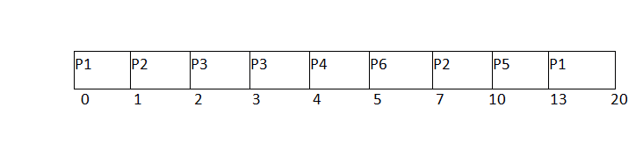
Process ID | Arrival Time | Burst Time | Completi on Time | Turn Around Time | Waiting Time | Respons e Time
1 | 0 | 8 | 20 | 20 | 12 | 0
2 | 1 | 4 | 10 | 9 | 5 | 1
3 | 2 | 2 | 4 | 2 | 0 | 2
4 | 3 | 1 | 5 | 2 | 1 | 4
5 | 4 | 3 | 13 | 9 | 6 | 10
6 | 5 | 2 | 7 | 2 | 0 | 5
Avg Waiting Time = 24/6
The Gantt chart is prepared according to the arrival and burst time given in
the table.

Slide 60
Since, at time 0, the only available process is P1 with CPU burst time 8. This is the only available process in the list therefore it is scheduled.
The next process arrives at time unit 1. Since the algorithm we are using is SRTF which is a preemptive one, the current execution is stopped and the scheduler checks for the process with the least burst time. Till now, there are two processes available in the ready queue. The OS has executed P1 for one unit of time till now; the remaining burst time of P1 is 7 units. The burst time of Process P2 is 4 units. Hence Process P2 is scheduled on the CPU according to the algorithm.
The next process P3 arrives at time unit 2. At this time, the execution of process P3 is stopped and the process with the least remaining burst time is searched. Since the process P3 has 2 unit of burst time hence it will be given priority over others.
The Next Process P4 arrives at time unit 3. At this arrival, the scheduler will stop the execution of P4 and check which process is having least burst time among the available processes (P1, P2, P3 and P4). P1 and P2 are having the remaining burst time 7 units and 3 units respectively.
P3 and P4 are having the remaining burst time 1 unit each. Since, both are equal hence the scheduling will be done according to their arrival time. P3 arrives earlier than P4 and therefore it will be scheduled again. The Next Process P5 arrives at time unit 4. Till this time, the Process P3 has completed its execution and it is no more in the list. The scheduler will compare the remaining burst time of all the available processes. Since the burst time of process P4 is 1 which is least among all hence this will be scheduled.
The Next Process P6 arrives at time unit 5, till this time, the Process P4 has completed its execution. We have 4 available processes till now, that are P1 (7), P2 (3), P5 (3) and P6 (2). The Burst time of P6 is the least among all hence P6 is scheduled. Since, now, all the processes are available hence the algorithm will now work same as SJF. P6 will be executed till its completion and then the process with the least remaining time will be scheduled.
Once all the processes arrive, No preemption is done and the algorithm will work as SJF.

Slide 61
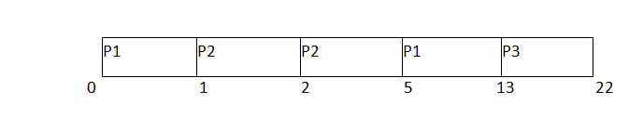
SRTF GATE 2011 Example
Q. Given the arrival time and burst time of 3 jobs in the table below. Calculate the Average waiting time of the system.
There are three jobs P1, P2 and P3. P1 arrives at time unit 0; it will be scheduled first for the time until the next process arrives. P2 arrives at 1 unit of time. Its burst time is 4 units which is least among the jobs in the queue. Hence it will be scheduled next.
At time 2, P3 will arrive with burst time 9. Since remaining burst time of P2 is 3 units which are least among the available jobs. Hence the processor will continue its execution till its completion. Because all the jobs have been arrived so no preemption will be done now and all the jobs will be executed till the completion according to SJF.
Process ID | Arrival Time | Burst Time | Completion Time | Turn Around Time | Waiting Time
1 | 0 | 9 | 13 | 13 | 4
2 | 1 | 4 | 5 | 4 | 0
3 | 2 | 9 | 22 | 20 | 11
Avg Waiting Time = (4+0+11)/3 = 5 units

Slide 62
Round Robin Scheduling Algorithm
What is Round Robin Scheduling in OS?
The Round robin scheduling algorithm is one of the CPU scheduling algorithms in which
every process gets a fixed amount of time quantum to execute the process.
In this algorithm, every process gets executed cyclically. This means that processes that have their burst time remaining after the expiration of the time quantum are sent back to the ready state and wait for their next turn to complete the execution until it terminates. This processing is done in FIFO order which suggests that processes are executed on a first-come, first-serve basis.
Note: The CPU time quantum is the time period defined in the system.
How does the Round Robin Algorithm Work?
All the processes are added to the ready queue.
At first, The burst time of every process is compared to the time quantum of the CPU. If the burst time of the process is less than or equal to the time quantum in the round- robin scheduling algorithm, the process is executed to its burst time.
If the burst time of the process is greater than the time quantum, the process is
executed up to the time quantum (TQ).
When the time quantum expires, it checks if the process is executed completely or
not.
On completion, the process terminates. Else, it goes back again to the ready state. Consider the below flow diagram for a better understanding of round robin scheduling algorithm:

Slide 63
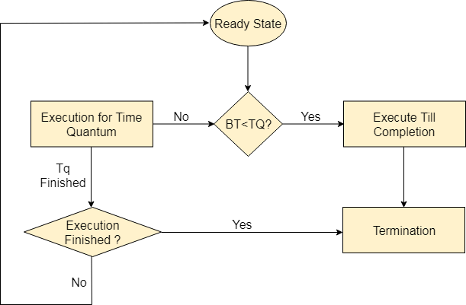

Slide 64
Advantages
The Advantages of Round Robin CPU Scheduling are:
A fair amount of CPU is allocated to each job.
Because it doesn't depend on the burst time, it can truly be implemented in the
system.
It is not affected by the convoy effect or the starvation problem as occurred in First
come First Serve CPU Scheduling Algorithm.
Disadvantages
The Disadvantages of Round Robin CPU Scheduling are:
Low Operating System slicing times will result in decreased CPU output.
Round Robin CPU Scheduling approach takes longer to swap contexts.
Time quantum has a significant impact on its performance.
The procedures cannot have priorities established.

Slide 65
Example of Round Robin Scheduling Algorithm
Consider the following 6 processes: P1, P2, P3, P4, P5, and P6 with their arrival time and
burst time as given below:
Q. What are the average waiting and turnaround times for the round-robin scheduling
algorithm (RR) with a time quantum of 4 units?
Process ID | Arrival Time | Burst Time
P1 | 0 | 5
P2 | 1 | 6
P3 | 2 | 3
P4 | 3 | 1
P5 | 4 | 5
P6 | 5 | 4

Slide 66
Ready Queue:
At first, In the ready queue, process P1 will be executed for a time slice of 4 units. Since there are no processes initially, Process P1, with a burst time of 5 units, will be the only process in the ready queue.
P1
5
Ready Queue:
Along with the execution of P1, four more processes, P2, P3, P4, and P5, arrive in the ready queue. P1 will be added to the ready queue due to the remaining 1 unit.
P2 | P3 | P4 | P5 | P1
6 | 3 | 1 | 5 | 1
Ready Queue:
During the execution of P2, P6 arrived in the ready queue. Since P2 has not been
completed, P2 will be added to the ready queue.

Slide 67
P3 | P4 | P5 | P1 | P6 | P2
3 | 1 | 5 | 1 | 4 | 2
Ready Queue:
Similarly, P3 and P4 have been completed, but P5 has a remaining burst time of 1 unit.
Hence it will be added back to the queue.
P1 | P6 | P2 | P5
1 | 4 | 2 | 1
Ready Queue:
The next processes, P6 and P2, will be executed. Only P5 will be left with 1 unit of burst
time.
P5
1

Slide 68
The Gantt chart will look like this:
As we know,
Turn Around Time = Completion Time - Arrival Time
Waiting Time = Turn Around Time - Burst Time

Slide 69
Processes | Arrival Time (AT) | Burst Time (BT) | Turn Around Time (TAT) | Waiting Time (WT)
P1 | 0 | 5 | 17 | 12
P2 | 1 | 6 | 22 | 16
P3 | 2 | 3 | 9 | 6
P4 | 3 | 1 | 9 | 8
P5 | 4 | 5 | 20 | 15
P6 | 6 | 4 | 15 | 11
Avg Waiting Time = (11+5+8+6+16+12)/6 =
68/6 = 11.33 units.

Slide 72
Examples:
S. No Process ID
_ _ _ _ _ _ _ _ _
Arrival Time
Burst Time
_ _ _ _ _ _
_ _ _ _ _ _ _
1 | P 1 | 0 | 7
2 | P 2 | 1 | 4
3 | P 3 | 2 | 15
4 | P 4 | 3 | 11
5 | P 5 | 4 | 20
6 | P 6 | 4 | 9
Assume Time Quantum TQ = 5
Ready Queue:
P1, P2, P3, P4, P5, P6, P1, P3, P4, P5, P6, P3, P4, P5

Slide 73
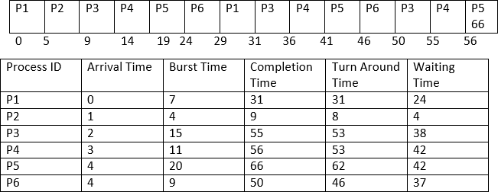
Gantt chart:
Average Completion Time
Average Completion Time = ( 31 +9 + 55 +56 +66 + 50 ) / 6
Average Completion Time = 267 / 6 Average Completion Time = 44.5 Average Waiting Time
Average Waiting Time = ( 5 + 26 + 5 + 42 + 42 + 37 ) / 6 Average Waiting Time = 157 / 6
Average Waiting Time = 26.16667
Average Turn Around Time
Average Turn Around Time = ( 31 + 8 + 53 + 53 + 62 + 46 ) / 6 Average Turn Around Time = 253 / 6
Average Turn Around Time = 42.16667

Slide 74
Thread in Operating System
Within a program, a Thread is a separate execution path. It is a lightweight process that the operating system can schedule and run concurrently with other threads. The operating system creates and manages threads, and they share the same memory and resources as the program that created them. This enables multiple threads to collaborate and work efficiently within a single program.
A thread is a single sequence stream within a process. Threads are also called lightweight processes as they possess some of the properties of processes. Each thread belongs to exactly one process. In an operating system that supports multithreading, the process can consist of many threads.
Why Do We Need Thread?
Threads run in parallel improving the application performance. Each such thread has its own CPU state and
stack, but they share the address space of the process and the environment.
Threads can share common data so they do not need to use interprocess communication. Like the processes,
threads also have states like ready, executing, blocked, etc.
Priority can be assigned to the threads just like the process, and the highest priority thread is scheduled first. Each thread has its own Thread Control Block (TCB). Like the process, a context switch occurs for the thread, and register contents are saved in (TCB). As threads share the same address space and resources, synchronization is also required for the various activities of the thread.

Slide 75
Why Multi-Threading?
A thread is also known as a lightweight process. The idea is to achieve parallelism by dividing a process into multiple threads. For example, in a browser, multiple tabs can be different threads. MS Word uses multiple threads: one thread to format the text, another thread to process inputs, etc. More advantages of multithreading are discussed below.
Multithreading is a technique used in operating systems to improve the performance and responsiveness of computer systems. Multithreading allows multiple threads (i.e., lightweight processes) to share the same resources of a single process, such as the CPU, memory, and I/O devices.
Difference between Process and Thread

Slide 76
S.NO | Process | Thread
1. | Process means any program is in execution. | Thread means a segment of a process.
2. | The process takes more time to terminate. | The thread takes less time to terminate.
3. | It takes more time for creation. | It takes less time for creation.
4. | It also takes more time for context switching. | It takes less time for context switching.
5. | The process is less efficient in terms of communication. | Thread is more efficient in terms of communication.
6. | Multiprogramming holds the concepts of multi- process. | We don’t need multi programs in action for multiple threads because a single process consists of multiple threads.
7. | The process is isolated. | Threads share memory.
8. | The process is called the heavyweight process. | A Thread is lightweight as each thread in a process shares code, data, and resources.
9. | Process switching uses an interface in an operating system. | Thread switching does not require calling an operating system and causes an interrupt to the kernel.
10. | If one process is blocked then it will not affect the execution of other processes | If a user-level thread is blocked, then all other user-level threads are blocked.
11. | The process has its own Process Control Block, Stack, and Address Space. | Thread has Parents’ PCB, its own Thread Control Block, and Stack and common Address space.
12. | Changes to the parent process do not affect child processes. | Since all threads of the same process share address space and other resources so any changes to the main thread may affect the behavior of the other threads of the process.
13. | A system call is involved in it. | No system call is involved, it is created using APIs.
14. | The process does not share data with each other. | Threads share data with each other.

Slide 77
Advantages of Thread
Responsiveness: If the process is divided into multiple threads, if one thread completes
its execution, then its output can be immediately returned.
Faster context switch: Context switch time between threads is lower compared to the process context switch. Process context switching requires more overhead from the CPU.
Effective utilization of multiprocessor system: If we have multiple threads in a single process, then we can schedule multiple threads on multiple processors. This will make process execution faster.
Resource sharing: Resources like code, data, and files can be shared among all threads within a process. Note: Stacks and registers can’t be shared among the threads. Each thread has its own stack and registers.
Communication: Communication between multiple threads is easier, as the threads share a common address space. while in the process we have to follow some specific communication techniques for communication between the two processes.
Enhanced throughput of the system: If a process is divided into multiple threads, and each thread function is considered as one job, then the number of jobs completed per unit of time is increased, thus increasing the throughput of the system.

Slide 78
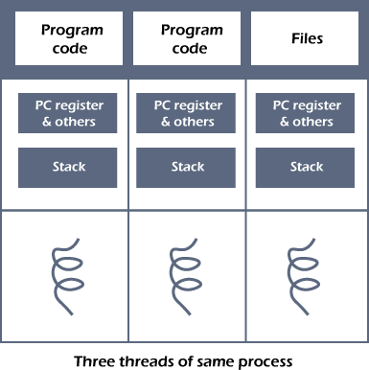
Types of Threads
Threads are of two types. These are described below.
User Level Thread Kernel Level Thread

Slide 79
User-level thread
The operating system does not recognize the user-level thread. User threads can be easily implemented and it is implemented by the user. If a user performs a user-level thread blocking operation, the whole process is blocked. The kernel level thread does not know nothing about the user level thread. The kernel-level thread manages user- level threads as if they are single-threaded processes. examples: Java thread, POSIX threads, etc.
Advantages of User-level threads
The user threads can be easily implemented than the kernel thread.
User-level threads can be applied to such types of operating systems that do not
support threads at the kernel-level. It is faster and efficient.
Context switch time is shorter than the kernel-level threads.
It does not require modifications of the operating system.
User-level threads representation is very simple. The register, PC, stack, and mini
thread control blocks are stored in the address space of the user-level process.
It is simple to create, switch, and synchronize threads without the intervention of the
process.

Slide 80
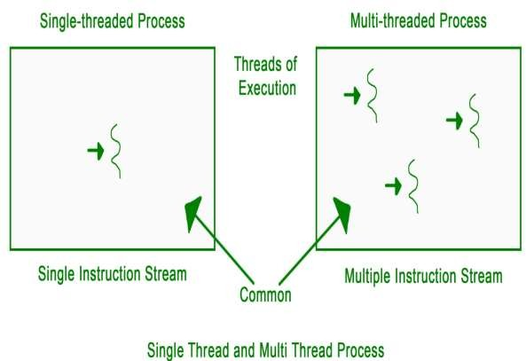
Disadvantages of User-level threads
User-level threads lack coordination between the thread and the kernel.
If a thread causes a page fault, the entire process is blocked.

Slide 81
Lifecycle of a thread
There are various stages in the lifecycle of a thread. Following are the stages a
thread goes through in its whole life.
New: The lifecycle of a born thread (new thread) starts in this state. It remains in this state till a program starts.
Runnable: A thread becomes runnable after it starts. It is considered to be
executing the task given to it.
Waiting: While waiting for another thread to perform a task, the currently running thread goes into the waiting state and then transitions back again after receiving a signal from the other thread.
Timed Waiting: A runnable thread enters into this state for a specific time interval and then transitions back when the time interval expires or the event the thread was waiting for occurs.
Terminated (Dead): A thread enters into this state after completing its task.

Slide 82
Process Synchronization in OS (Operating System)
When two or more process cooperates with each other, their order of execution must be preserved otherwise there can be conflicts in their execution and inappropriate outputs can be produced.
A cooperative process is the one which can affect the execution of other process or can be affected by the execution of other process. Such processes need to be synchronized so that their order of execution can be guaranteed.
The procedure involved in preserving the appropriate order of execution of cooperative processes is known as Process Synchronization. There are various synchronization mechanisms that are used to synchronize the processes.
Race Condition
A Race Condition typically occurs when two or more threads try to read, write and possibly
make the decisions based on the memory that they are accessing concurrently.
Critical Section
The regions of a program that try to access shared resources and may cause race conditions are called critical section. To avoid race condition among the processes, we need to assure that only one process at a time can execute within the critical section.

Slide 83
Critical Section Problem in OS
Critical Section is the part of a program which tries to access shared resources. That resource may be any resource in a computer like a memory location, Data structure, CPU or any IO device.
The critical section cannot be executed by more than one process at the same time; operating system faces the difficulties in allowing and disallowing the processes from entering the critical section.
The critical section problem is used to design a set of protocols which can ensure that
the Race condition among the processes will never arise.
In order to synchronize the cooperative processes, our main task is to solve the critical section problem. We need to provide a solution in such a way that the following conditions can be satisfied.
Requirements of Synchronization mechanisms
Primary
1. Mutual Exclusion
Our solution must provide mutual exclusion. By Mutual Exclusion, we mean that if one process is executing inside critical section then the other process must not enter in the critical section.

Slide 84
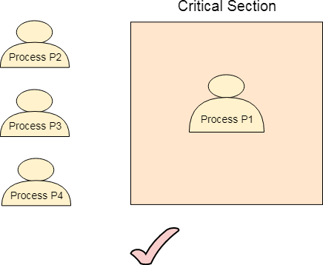
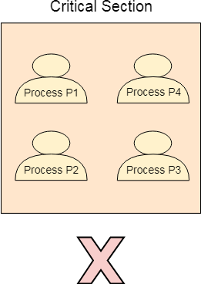

Slide 85
2. Progress
Progress means that if one process doesn't need to execute into critical section then it
should not stop other processes to get into the critical section.
Secondary
Bounded Waiting
We should be able to predict the waiting time for every process to get into the critical
section. The process must not be endlessly waiting for getting into the critical section.
Architectural Neutrality
Our mechanism must be architectural natural. It means that if our solution is working fine on one architecture then it should also run on the other ones as well.
Lock Variable
This is the simplest synchronization mechanism. This is a Software Mechanism implemented in User mode. This is a busy waiting solution which can be used for more than two processes.
In this mechanism, a Lock variable lock is used. Two values of lock can be possible, either 0 or 1. Lock value 0 means that the critical section is vacant while the lock value 1 means that it is occupied.
A process which wants to get into the critical section first checks the value of the lock variable. If it is 0 then it sets the value of lock as 1 and enters into the critical section, otherwise it waits.
The pseudo code of the mechanism looks like following.

Slide 86
Entry Section → While (lock! = 0); Lock = 1;
//Critical Section Exit Section → Lock =0;
If we look at the Pseudo Code, we find that there are three sections in the code. Entry Section, Critical Section and the exit section.
Initially the value of lock variable is 0. The process which needs to get into the critical section, enters into
the entry section and checks the condition provided in the while loop.
The process will wait infinitely until the value of lock is 1 (that is implied by while loop). Since, at the very first time critical section is vacant hence the process will enter the critical section by setting the lock variable as 1.
When the process exits from the critical section, then in the exit section, it reassigns the value of lock as 0.
Every Synchronization mechanism is judged on the basis of four conditions.
Mutual Exclusion
Progress
Bounded Waiting
Portability
Out of the four parameters, Mutual Exclusion and Progress must be provided by any solution. Lets analyze
this mechanism on the basis of the above mentioned conditions.

Slide 87
Mutual Exclusion
The lock variable mechanism doesn't provide Mutual Exclusion in some of the cases. This can be better described by looking at the pseudo code by the Operating System point of view i.e. Assembly code of the program. Let's convert the Code into the assembly language.
Load Lock, R0
CMP R0, #0
JNZ Step 1
Store #1, Lock
Store #0, Lock
Let us consider that we have two processes P1 and P2. The process P1 wants to execute its critical section. P1 gets into the entry section. Since the value of lock is 0 hence P1 changes its value from 0 to 1 and enters into the critical section.
Meanwhile, P1 is preempted by the CPU and P2 gets scheduled. Now there is no other process in the critical section and the value of lock variable is 0. P2 also wants to execute its critical section. It enters into the critical section by setting the lock variable to 1.
Now, CPU changes P1's state from waiting to running. P1 is yet to finish its critical section. P1 has already checked the value of lock variable and remembers that its value was 0 when it previously checked it. Hence, it also enters into the critical section without checking the updated value of lock variable.

Slide 88
Now, we got two processes in the critical section. According to the condition of mutual exclusion, more than one process in the critical section must not be present at the same time. Hence, the lock variable mechanism doesn't guarantee the mutual exclusion.
The problem with the lock variable mechanism is that, at the same time, more than one process can see the vacant tag and more than one process can enter in the critical section. Hence, the lock variable doesn't provide the mutual exclusion that's why it cannot be used in general.
Since, this method is failed at the basic step; hence, there is no need to talk about the
other conditions to be fulfilled.

Slide 89
Test Set Lock Mechanism
Modification in the assembly code
In lock variable mechanism, Sometimes Process reads the old value of lock variable and enters the critical section. Due to this reason, more than one process might get into critical section. However, the code shown in the part one of the following section can be replaced with the code shown in the part two. This doesn't affect the algorithm but, by doing this, we can manage to provide the mutual exclusion to some extent but not completely.
In the updated version of code, the value of Lock is loaded into the local register R0 and then value of lock is set to 1.
However, in step 3, the previous value of lock (that is now stored into R0) is compared with 0. if this is 0 then the process will simply enter into the critical section otherwise will wait by executing continuously in the loop.
The benefit of setting the lock immediately to 1 by the process itself is that, now the process which enters into the critical section carries the updated value of lock variable that is 1.
In the case when it gets preempted and scheduled again then also it will not enter the critical section regardless of the current value of the lock variable as it already knows what the updated value of lock variable is.

Slide 90
Section 1 | Section 2
Load Lock, R0 CMP R0, #0 JNZ step1 store #1, Lock | Load Lock, R0 Store #1, Lock CMP R0, #0 JNZ step 1
TSL Instruction
However, the solution provided in the above segment provides mutual exclusion to some extent but it doesn't make sure that the mutual exclusion will always be there. There is a possibility of having more than one process in the critical section.
What if the process gets preempted just after executing the first instruction of the assembly code written in section 2? In that case, it will carry the old value of lock variable with it and it will enter into the critical section regardless of knowing the current value of lock variable. This may make the two processes present in the critical section at the same time.
To get rid of this problem, we have to make sure that the preemption must not take place just after loading the previous value of lock variable and before setting it to 1. The problem can be solved if we can be able to merge the first two instructions.
In order to address the problem, the operating system provides a special instruction called Test Set Lock (TSL) instruction which simply loads the value of lock variable into the local register R0 and sets it to 1 simultaneously
The process which executes the TSL first will enter into the critical section and no other process after that can enter until the first process comes out. No process can execute the critical section even in the case of preemption of the first process.
The assembly code of the solution will look like following.
TSL Lock, R0 CMP R0, #0
JNZ step 1
Let's examine TSL on the basis of the four conditions.

Slide 91
Mutual Exclusion
Mutual Exclusion is guaranteed in TSL mechanism since a process can never be preempted just before setting the lock variable. Only one process can see the lock variable as 0 at a particular time and that's why, the mutual exclusion is guaranteed.
Progress
According to the definition of the progress, a process which doesn't want to enter in the critical section should not stop other processes to get into it. In TSL mechanism, a process will execute the TSL instruction only when it wants to get into the critical section. The value of the lock will always be 0 if no process doesn't want to enter into the critical section hence the progress is always guaranteed in TSL.
Bounded Waiting
Bounded Waiting is not guaranteed in TSL. Some process might not get a chance for so long. We cannot predict for a process that it will definitely get a chance to enter in critical section after a certain time.
Architectural Neutrality
TSL doesn't provide Architectural Neutrality. It depends on the hardware platform. The TSL instruction is provided by the operating system. Some platforms might not provide that. Hence it is not Architectural natural.

Slide 92
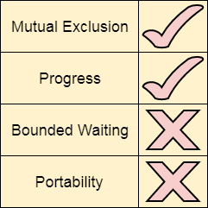
Priority Inversion
In TSL mechanism, there can be a problem of priority inversion. Let?s say that there are
two cooperative processes, P1 and P2.
The priority of P1 is 2 while that of P2 is 1. P1 arrives earlier and got scheduled by the CPU. Since it is a cooperative process and wants to execute in the critical section hence it will enter in the critical section by setting the lock variable to 1.
Now, P2 arrives in the ready queue. The priority of P2 is higher than P1 hence according to priority scheduling, P2 is scheduled and P1 got preempted. P2 is also a cooperative process and wants to execute inside the critical section.

Slide 93
Although, P1 got preempted but it the value of lock variable will be shown as 1 since P1
is not completed and it is yet to finish its critical section.
P1 needs to finish the critical section but according to the scheduling algorithm, CPU is with P2. P2 wants to execute in the critical section, but according to the synchronization mechanism, critical section is with P1.
This is a kind of lock where each of the process neither executes nor completes. Such
kind of lock is called Spin Lock.
This is different from deadlock since they are not in blocked state. One is in ready state
and the other is in running state, but neither of the two is being executed.
Turn Variable or Strict Alternation Approach
Turn Variable or Strict Alternation Approach is the software mechanism implemented at user mode. It is a busy waiting solution which can be implemented only for two processes. In this approach, A turn variable is used which is actually a lock.
This approach can only be used for only two processes. In general, let the two processes be Pi and Pj. They share a variable called turn variable. The pseudo code of the program can be given as following.

Slide 94
For Process Pi
Non - CS
while (turn ! = i); Critical Section turn = j;
Non - CS
For Process Pj
Non - CS
while (turn ! = j); Critical Section turn = i ;
Non - CS

Slide 95
Sleep and Wake
(Producer Consumer problem)
Let's examine the basic model that is sleep and wake. Assume that we have two system calls as sleep and wake. The process which calls sleep will get blocked while the process which calls wake will get waked up.
There is a popular example called producer consumer problem which is the most
popular problem simulating sleep and wake mechanism.
The concept of sleep and wake is very simple. If the critical section is not empty then the process will go and sleep. It will be waked up by the other process which is currently executing inside the critical section so that the process can get inside the critical section.
In producer consumer problem, let us say there are two processes, one process writes something while the other process reads that. The process which is writing something is called producer while the process which is reading is called consumer.
In order to read and write, both of them are using a buffer. The code that simulates the sleep and wake mechanism in terms of providing the solution to producer consumer problem is shown below.

Slide 97
Turn Variable or Strict Alternation Approach
Turn Variable or Strict Alternation Approach is the software mechanism implemented at user mode. It is a busy waiting solution which can be implemented only for two processes. In this approach, A turn variable is used which is actually a lock.
This approach can only be used for only two processes. In general, let the two processes be Pi and Pj. They share a variable called turn variable. The pseudo code of the program can be given as following.
For Process Pi
Non - CS
while (turn ! = i); Critical Section turn = j;
Non - CS
For Process Pj
Non - CS
while (turn ! = j); Critical Section turn = i ;
Non - CS

Slide 98
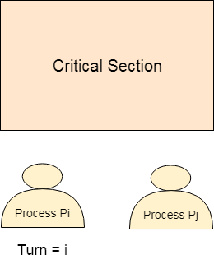
The actual problem of the lock variable approach was the fact that the process was entering in the critical section only when the lock variable is 1. More than one process could see the lock variable as 1 at the same time hence the mutual exclusion was not guaranteed there.
This problem is addressed in the turn variable approach. Now, A process can enter in the critical section only in the case when the value of the turn variable equal to the PID of the process.
There are only two values possible for turn variable, i or j. if its value is not i then it will
definitely be j or vice versa.
In the entry section, in general, the process Pi will not enter in the critical section until its value is j or the process Pj will not enter in the critical section until its value is i.
Initially, two processes Pi and Pj are available and want to execute into critical section.

Slide 99
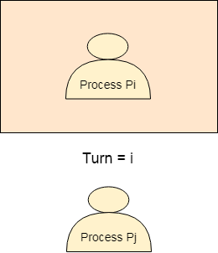
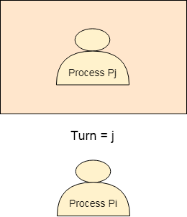
The turn variable is equal to i hence Pi will get the chance to enter into the critical
section. The value of Pi remains I until Pi finishes critical section.
Pi finishes its critical section and assigns j to turn variable. Pj will get the chance to enter into the critical section. The value of turn remains j until Pj finishes its critical section.

Slide 100
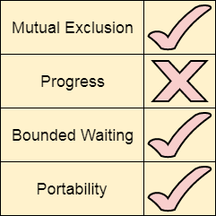
Analysis of Strict Alternation approach
Let's analyze Strict Alternation approach on the basis of four requirements.
Mutual Exclusion
The strict alternation approach provides mutual exclusion in every case. This procedure works only for two processes. The pseudo code is different for both of the processes. The process will only enter when it sees that the turn variable is equal to its Process ID otherwise not Hence No process can enter in the critical section regardless of its turn.
Progress
Progress is not guaranteed in this mechanism. If Pi doesn't want to get enter into the critical section on its turn then Pj got blocked for infinite time. Pj has to wait for so long for its turn since the turn variable will remain 0 until Pi assigns it to j.
Portability
The solution provides portability. It is a pure software mechanism implemented at
user mode and doesn't need any special instruction from the Operating System.

Slide 101
Interested Variable Mechanism
We have to make sure that the progress must be provided by our synchronization mechanism. In the turn variable mechanism, progress was not provided due to the fact that the process which doesn't want to enter in the critical section does not consider the other interested process as well.
The other process will also have to wait regardless of the fact that there is no one inside the critical section. If the operating system can make use of an extra variable along with the turn variable then this problem can be solved and our problem can provide progress to most of the extent.
Interested variable mechanism makes use of an extra Boolean variable to make sure
that the progress is provided.
For Process Pi
Non CS Int[i] = T ;
while ( Int[j] == T ) ; Critical Section Int[i] = F ;
For Process Pj
Non CS
Int [1] = T ;
while ( Int[i] == T ) ; Critical Section Int[j]=F ;

Slide 102
In this mechanism, an extra variable interested is used. This is a Boolean variable used
to store the interest of the processes to get enter inside the critical section.
A process which wants to enter in the critical section first checks in the entry section whether the other process is interested to get inside. The process will wait for the time until the other process is interested.
In exit section, the process makes the value of its interest variable false so that the
other process can get into the critical section.
The table shows the possible values of interest variable of both the processes and the
process which get the chance in the scenario.
Interest [Pi] | Interest [Pj] | Process which get the chance
True | True | The process which first shows interest.
True | False | Pi
False | True | Pj
False | False | X
Let's analyze the mechanism on the basis of
the requirements.

Slide 103
Mutual Exclusion
In interested variable mechanism, if one process is interested in getting into the CPU then the other process will wait until it becomes uninterested. Therefore, more than one process can never be present in the critical section at the same time hence the mechanism guarantees mutual exclusion.
Progress
In this mechanism, if a process is not interested in getting into the critical section then it will not stop the other
process from getting into the critical section. Therefore the progress will definitely be provided by this method.
Bounded Waiting
To analyze bounded waiting, let us consider two processes Pi and Pj, are the cooperative processes wants to
execute in the critical section. The instructions executed by the processes are shown below in relative manner.
Process Pi | Process Pj | Process Pi | Process Pj
Int [Pi] = True while (Int [Pj] == True); Critical Section | Int [Pj] = True while (Int[Pi]==True); | Int [Pi] = False Int [Pi] = True while (Int [Pj] == True); //waiting for Pj | 1. While (Int [Pi] == True); //waiting for Pj
Initially, the interest variable of both the processes is false. The process Pi shows the interest to get inside the
critical section.
It sets its Interest Variable to true and check whether the Pj is also interested or not. Since the other process's
interest variable is false hence Pi will get enter into the critical section.
Meanwhile, the process Pi is preempted and Pj is scheduled. Pj is a cooperative process and therefore, it also wants to enter in the critical section. It shows its interest by setting the interest variable to true.
It also checks whether the other process is also interested or not. We should notice that Pi is preempted but its interested variable is true that means it needs to further execute in the critical section. Therefore Pj will not get the chance and gets stuck in the while loop.
Meanwhile, CPU changes Pi's state from blocked to running. Pi is yet to finish its critical section hence it finishes the critical section and makes an exit by setting the interest variable to False.

Slide 104
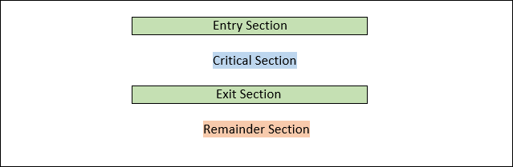
Semaphore Definition
Semaphore is a Hardware Solution. This Hardware solution is written or given to
critical section problem.
What is a Critical Section Problem?
The Critical Section Problem is a Code Snippet. This code snippet contains a few variables. These variables can be accessed by a few processes. There is a condition for these processes.
The condition is that only one process can only enter the critical section. Remaining Processes which are interested to enter the critical section have to wait for the process to complete its work and then enter the critical section.
Critical Section Representation

Slide 105
Problems in Critical Section Problems
There may be a state where one or more processes try to enter the critical state. After multiple processes enter the Critical Section, the second process try to access variable which already accessed by the first process.
Explanation
Suppose there is a variable which is also known as shared variable. Let us define that
shared variable.
Here, x is the shared variable.
int x = 10;
Process 1
// Process 1 int s = 10; int u = 20;
x = s + u;
Process 2
// Process 2 int s = 10; int u = 20;
x = s - u;

Slide 106
If the process is accessed the x shared variable one after other, then we are going to be
in a good position.
If Process 1 is alone executed, then the value of x is denoted as x = 30; The shared variable x changes to 30 from 10
If Process 2 is alone executed, then the value of x is denoted as x = -10; The shared variable x changes to -10 from 30
If both the processes occur at the same time, then the compiler would be in a confusion to choose which variable value i.e. -10 or 30. This state faced by the variable x is Data Inconsistency. These problems can also be solved by Hardware Locks
To, prevent such kind of problems can also be solved by Hardware solutions named Semaphores.

Slide 107
Semaphores
The Semaphore is just a normal integer. The Semaphore cannot be negative. The least value for a Semaphore is zero (0). The Maximum value of a Semaphore can be anything. The Semaphores usually have two operations. The two operations have the capability to decide the values of the semaphores.
The two Semaphore Operations are:
Wait ( )
Signal ( )
Wait Semaphore Operation
The Wait Operation is used for deciding the condition for the process to enter the critical state or wait for execution of process. Here, the wait operation has many different names. The different names are:
Sleep Operation Down Operation Decrease Operation
P Function (most important alias name for wait operation)
The Wait Operation works on the basis of Semaphore or Mutex Value.
Here, if the Semaphore value is greater than zero or positive then the Process can enter the Critical
Section Area.
If the Semaphore value is equal to zero then the Process has to wait for the Process to exit the Critical Section Area.
This function is only present until the process enters the critical state. If the Processes enters the
critical state, then the P Function or Wait Operation has no job to do.
If the Process exits the Critical Section we have to reduce the value of Semaphore

Slide 108
Basic Algorithm of P Function or Wait Operation
P (Semaphore value)
{
Allow the process to enter if the value of Semaphore is greater than zero or positive.
Do not allow the process if the value of Semaphore is less than zero or ze
ro.
Decrement the Semaphore value if the Process leaves the Critical State.
}
Signal Semaphore Operation
The Signal Semaphore Operation is used to update the value of Semaphore. The Semaphore value is updated when the
new processes are ready to enter the Critical Section. The Signal Operation is also known as:
Wake up Operation Up Operation Increase Operation
V Function (most important alias name for signal operation)
We know that the semaphore value is decreased by one in the wait operation when the process left the critical state. So, to counter balance the decreased number 1 we use signal operation which increments the semaphore value. This induces the critical section to receive more and more processes into it.
The most important part is that this Signal Operation or V Function is executed only when the process comes out of the
critical section. The value of semaphore cannot be incremented before the exit of process from the critical section

Slide 109
Basic Algorithm of V Function or Signal Operation
V (Semaphore value)
{
If the process goes out of the critical section then add 1 to the semaphore valu
e
Else keep calm until process exits
}
Types of Semaphores
There are two types of Semaphores. They are:
Binary Semaphore
Here, there are only two values of Semaphore in Binary Semaphore Concept. The two values are 1 and 0.
If the Value of Binary Semaphore is 1, then the process has the capability to enter the critical section area. If the value of Binary Semaphore is 0 then the process does not have the capability to enter the critical section area.
Counting Semaphore
Here, there are two sets of values of Semaphore in Counting Semaphore Concept. The two types of
values are values greater than and equal to one and other type is value equal to zero.
If the Value of Binary Semaphore is greater than or equal to 1, then the process has the capability to enter the critical section area. If the value of Binary Semaphore is 0 then the process does not have the capability to enter the critical section area.

Slide 110
Advantages of a Semaphore
Semaphores are machine independent since their implementation and codes are
written in the microkernel's machine independent code area.
They strictly enforce mutual exclusion and let processes enter the crucial part one at a time (only in the case of binary semaphores).
With the use of semaphores, no resources are lost due to busy waiting since we do not need any processor time to verify that a condition is met before allowing a process access to the crucial area.
Semaphores have the very good management of resources
They forbid several processes from entering the crucial area. They are significantly more effective than other synchronization approaches since mutual exclusion is made possible in this way.
Disadvantages of a Semaphore
Due to the employment of semaphores, it is possible for high priority processes to
reach the vital area before low priority processes.
Because semaphores are a little complex, it is important to design the wait and signal
actions in a way that avoids deadlocks.
Programming a semaphore is very challenging, and there is a danger that mutual
exclusion won't be achieved.
The wait ( ) and signal ( ) actions must be carried out in the appropriate order to
prevent deadlocks.

Slide 111
Solving Classical Synchronization Problems using Semaphore Concept
1) Solving Readers - Writers Problem using Semaphore
Definition:
First of all let us all know about the Readers - Writers Problem.
In Readers - Writers Problems there are two Actors for the problem. They are Reader and Writer. The Reader - Writer Problem tries to access or change the value of the Shared Variable. Due to this, parallel execution of accessing and changing operation data faults take place. Due to this, expected outputs are not the actual outputs of the problem. This is the problem of Readers - Writers
The duties of Readers and Writers are different from each other.
The Reader duty is to read the value of the Shared Variable. The Writer duty is to change the value of the Shared Variable. Now, let us solve this problem with the help of a Semaphore. Required Data
First of all let us consider there is Critical Section which contains a shared variable. Let us consider that there are two processes. The first process is the one which always tries to access the shared variable. The second process is the one which always tries to change the value of the variable.
Solution

Slide 112
So, we can allow the reader if the value of semaphore 1.
Algorithm for Solving Readers - Writers Problem with the help of Binary Semaphore
/* Process 1 - - - > Reader Process 2 - - - > Writer */ Solving (int n)
{
if (n==0)
{
//You cannot enter the critical section area.
}
if (n==1)
{
Enter the process which you want to perform
scan (op)
if (op==1)
{
Read ( )
} // read
else if (op==2)
{
Write ( )
} // write
} // if condition for entering critical section
} // Solving
Main ( )
{
do
{
{
Process (Semaphore)
// Enter the Entry section if the Semaphore value is one. Entry Section
Critical Section
Exit Section
} // Entry Section
} // main

Slide 113
Solving Readers - Writers Problem with the help of Counting Semaphore
We know that the Counting Semaphore allows the process to enter the critical
section if the value of Counting Semaphore is greater than or equal to 1.
Now, we are going to allow the writer to work or execute its task if the value of Counting Semaphore value is greater than or equal to 1. This allows that the data changes are error free.
We can allow the reader to work or execute its task if the value of Counting Semaphore is greater than or equal to 1 or Counting Semaphore is equal to 0. This is because the Reader just reads the value of Shared Variable. But according to the rules laid by the Semaphore we can only enter the critical section if the value of Counting Semaphore is greater than or equal to 1.
So, we can allow the reader if the value of Counting Semaphore is greater than or
equal to 1.
Algorithm for Solving Readers - Writers Problem with the help of Binary
Semaphore

Slide 114
/* Process 1 - - - > Reader Process 2 - - - > Writer */ Solving (int n)
{
if (n==0)
{
//You cannot enter the critical section area.
}
if (n>=1)
{
Enter the process which you want to perform
scan (op)
if (op==1)
{
Read ( )
} // read
else if (op==2)
{
Write ( )
} // write
} // if condition for entering critical section
} // Solving
Main ( )
{
do
{
Process (Semaphore)
// Enter the Entry section if the Semaphore value is greater or equal to one. Entry Section
Critical Section Exit Section Remainder Section
} // do
while (true);
} // Entry Section
} // main

Slide 115
2. Solving Bound Buffer Problem using the concept of Semaphores
Definition:
The Producer-Consumer problem is another name for Bound Buffer Problem. In this issue, there are n slots in a buffer, and each slot may hold one data unit. Producer and Consumer are the two operations that are using the buffer. Both the producer and the consumer attempt to enter and delete data.
Solution:
Now, we are going to solve the problem faced in the Bound Buffer or Producer
Consumer Problem.
We already know that the duty of the Producer is to enter data in which ever area
possible.
The duty of Consumer is to remove the data produced by the Producer or already
present data where ever possible.
Now, let us understand how these two Producers and Consumers are going to work along with the concepts of Binary and Counting Semaphore.
Solving Bound Buffer or Producer Consumer Problem with the help of Binary
Semaphore
We know that the Binary Semaphore allows the process to enter the critical section if
the value of Binary Semaphore is 1.
Now, we are going to allow the writer to work or execute its task if the value of Binary
Semaphore value is 1. This allows that the data changes are error free.

Slide 116
Now, let us assume that the Producer is creating a few shared variables inside the critical section.
Now, let us allow the process named Producer and produce new value inside the critical section after entering the Critical Section. The entry is accepted only if the value of Binary Semaphore is equal to 1.
Now, let us allow the process named Consumer and delete the processes created after entering the Critical Section. The entry is accepted only if the value of Binary Semaphore is equal to 1.
Now, it is our duty to prevent the Producer and Consumer gets executed at the same time. So, we give the user or the computer an option to choose which operation to be performed at the time of Entering the Entry Section of the Critical Section
Solving Bound Buffer or Producer Consumer Problem with the help of Counting Semaphore
We know that the Binary Semaphore allows the process to enter the critical
section if the value of Counting Semaphore is 1 or greater than 1.

Slide 117
Now, we are going to allow the writer to work or execute its task if the value of Counting Semaphore is 1 or greater than 1. This allows that the data changes are error free.
Now, let us assume that the Producer is creating a few shared variables inside
the critical section.
Now, let us allow the process named Producer and produce new value inside the critical section after entering the Critical Section. The entry is accepted only if the value of Counting Semaphore is equal to or greater than 1.
Now, let us allow the process named Consumer and delete the processes created after entering the Critical Section. The entry is accepted only if the value of Counting Semaphore is 1 or greater than 1.
Now, it is our duty to prevent the Producer and Consumer gets executed at the same time. So, we give the user or the computer an option to choose which operation to be performed at the time of Entering the Entry Section of the Critical Section
3. Solving Dining Philosopher's Problem using the concept of Semaphores
Definition:

Slide 118

The dining philosopher's problem is the classical problem of synchronization which says that Five philosophers are sitting around a circular table and their job is to think and eat alternatively. A bowl of noodles is placed at the center of the table along with five chopsticks for each of the philosophers. To eat a philosopher needs both their right and a left chopstick. A philosopher can only eat if both immediate left and right chopsticks of the philosopher is available. In case if both immediate left and right chopsticks of the philosopher are not available then the philosopher puts down their (either left or right) chopstick and starts thinking again.
The dining philosopher demonstrates a large class of concurrency control problems
hence it's a classic synchronization problem.

Slide 119
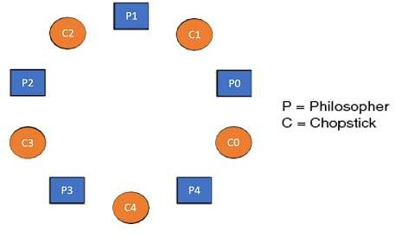
Dining Philosophers Problem- Let's understand the Dining Philosophers Problem with the below code, we have used fig 1 as a reference to make you understand the problem exactly. The five Philosophers are represented as P0, P1, P2, P3, and P4 and five chopsticks by C0, C1, C2, C3, and C4.

Slide 120
Void Philosopher
{
while(1)
{
take_chopstick[i];
take_chopstick[ (i+1) % 5] ;
. .
. EATING THE NOODLE
.
put_chopstick[i] ); put_chopstick[ (i+1) % 5] ;
.
. THINKING
}
}
Let's discuss the above code:
Suppose Philosopher P0 wants to eat, it will enter in Philosopher() function, and execute take_chopstick[i]; by doing this it holds C0 chopstick after that it execute take_chopstick[ (i+1) % 5]; by doing this it holds C1 chopstick( since i =0, therefore (0 + 1) % 5 = 1)
Similarly suppose now Philosopher P1 wants to eat, it will enter in Philosopher() function, and execute take_chopstick[i]; by doing this it holds C1 chopstick after that it execute take_chopstick[ (i+1) % 5]; by doing this it holds C2 chopstick( since i =1, therefore (1 + 1) % 5 = 2)
But Practically Chopstick C1 is not available as it has already been taken by philosopher P0, hence the above code generates problems and produces race condition.

Slide 121
The solution of the Dining Philosophers Problem
We use a semaphore to represent a chopstick and this truly acts as a solution of the Dining Philosophers Problem. Wait and Signal operations will be used for the solution of the Dining Philosophers Problem, for picking a chopstick wait operation can be executed while for releasing a chopstick signal semaphore can be executed.
Semaphore: A semaphore is an integer variable in S, that apart from initialization is accessed by only two standard atomic operations - wait and signal, whose definitions are as follows:
wait( S )
{
while( S <= 0) ; S--;
}
signal( S )
{
S++;
}
From the above definitions of wait, it is clear that if the value of S <= 0 then it will enter into an infinite loop(because of the semicolon; after while loop). Whereas the job of the signal is to increment the value of S. The structure of the chopstick is an array of a semaphore which is represented as shown below -
semaphore C[5];
Initially, each element of the semaphore C0, C1, C2, C3, and C4 are initialized to 1 as the chopsticks are on the
table and not picked up by any of the philosophers.

Slide 122
Let's modify the above code of the Dining Philosopher Problem by using semaphore operations wait and signal, the desired code looks like
void Philosopher
{
while(1)
{
Wait( take_chopstickC[i] );
Wait( take_chopstickC[(i+1) % 5] ) ;
. .
. EATING THE NOODLE
.
Signal( put_chopstickC[i] );
Signal( put_chopstickC[ (i+1) % 5] ) ;
.
. THINKING
}
}

Slide 123
In the above code, first wait operation is performed on take_chopstickC[i] and take_chopstickC [ (i+1) % 5]. This shows philosopher i have picked up the chopsticks from its left and right. The eating function is performed after that.
On completion of eating by philosopher i the, signal operation is performed on take_chopstickC[i] and take_chopstickC [ (i+1) % 5]. This shows that the philosopher i have eaten and put down both the left and right chopsticks. Finally, the philosopher starts thinking again.
Let's understand how the above code is giving a solution to the dining philosopher problem?
Let value of i = 0( initial value ), Suppose Philosopher P0 wants to eat, it will enter in Philosopher() function, and execute Wait( take_chopstickC[i] ); by doing this it holds C0 chopstick and reduces semaphore C0 to 0, after that it execute Wait( take_chopstickC[(i+1) % 5] ); by doing this it holds C1 chopstick( since i =0, therefore (0 + 1) % 5 = 1) and reduces semaphore C1 to 0
Similarly, suppose now Philosopher P1 wants to eat, it will enter in Philosopher() function, and execute Wait( take_chopstickC[i] ); by doing this it will try to hold C1 chopstick but will not be able to do that, since the value of semaphore C1 has already been set to 0 by philosopher P0, therefore it will enter into an infinite loop because of which philosopher P1 will not be able to pick chopstick C1 whereas if Philosopher P2 wants to eat, it will enter in Philosopher() function, and execute Wait( take_chopstickC[i] ); by doing this it holds C2 chopstick and reduces semaphore C2 to 0, after that, it executes Wait( take_chopstickC[(i+1) % 5] ); by doing this it holds C3 chopstick( since i =2, therefore (2 + 1) % 5 = 3) and reduces semaphore C3 to 0.
Hence the above code is providing a solution to the dining philosopher problem, A philosopher can only eat if both immediate left and right chopsticks of the philosopher are available else philosopher needs to wait. Also at one go two independent philosophers can eat simultaneously (i.e., philosopher P0 and P2, P1 and P3 & P2 and P4 can eat simultaneously as all are the independent processes and they are following the above constraint of dining philosopher problem)

Slide 124
The drawback of the above solution of the dining philosopher problem
From the above solution of the dining philosopher problem, we have proved that no two neighboring philosophers can eat at the same point in time. The drawback of the above solution is that this solution can lead to a deadlock condition. This situation happens if all the philosophers pick their left chopstick at the same time, which leads to the condition of deadlock and none of the philosophers can eat.
To avoid deadlock, some of the solutions are as follows -
Maximum number of philosophers on the table should not be more than four, in this case, chopstick C4 will be available for philosopher P3, so P3 will start eating and after the finish of his eating procedure, he will put down his both the chopstick C3 and C4, i.e. semaphore C3 and C4 will now be incremented to 1. Now philosopher P2 which was holding chopstick C2 will also have chopstick C3 available, hence similarly, he will put down his chopstick after eating and enable other philosophers to eat.
A philosopher at an even position should pick the right chopstick and then the left chopstick while a philosopher at an odd position should pick the left chopstick and then the right chopstick.
Only in case if both the chopsticks ( left and right ) are available at the same time, only then a philosopher
should be allowed to pick their chopsticks
All the four starting philosophers ( P0, P1, P2, and P3) should pick the left chopstick and then the right chopstick, whereas the last philosopher P4 should pick the right chopstick and then the left chopstick. This will force P4 to hold his right chopstick first since the right chopstick of P4 is C0, which is already held by philosopher P0 and its value is set to 0, i.e. C0 is already 0, because of which P4 will get trapped into an infinite loop and chopstick C4 remains vacant. Hence philosopher P3 has both left C3 and right C4 chopstick available, therefore it will start eating and will put down its both chopsticks once finishes and let others eat which removes the problem of deadlock.

Slide 125
The design of the problem was to illustrate the challenges of avoiding deadlock, a deadlock state of a system is a state in which no progress of system is possible. Consider a proposal where each philosopher is instructed to behave as follows:
The philosopher is instructed to think till the left fork is available, when it is
available, hold it.
The philosopher is instructed to think till the right fork is available, when it is
available, hold it.
The philosopher is instructed to eat when both forks are available. then, put the right fork down first
then, put the left fork down next repeat from the beginning.

Slide 126
What is Deadlock in Operating System (OS)?
Every process needs some resources to complete its execution. However, the resource is granted in a sequential order.
The process requests for some resource.
OS grant the resource if it is available otherwise let the process waits.
The process uses it and release on the completion.
A Deadlock is a situation where each of the computer process waits for a resource which is being assigned to some another process. In this situation, none of the process gets executed since the resource it needs, is held by some other process which is also waiting for some other resource to be released.
Let us assume that there are three processes P1, P2 and P3. There are three different resources R1, R2 and R3. R1 is assigned to P1, R2 is assigned to P2 and R3 is assigned to P3.
After some time, P1 demands for R2 which is being used by P2. P1 halts its execution since it can't complete without R2. P2 also demands for R3 which is being used by P3. P2 also stops its execution because it can't continue without R3. P3 also demands for R1 which is being used by P1 therefore P3 also stops its execution.
In this scenario, a cycle is being formed among the three processes. None of the process is progressing and they are all waiting. The computer becomes unresponsive since all the processes got blocked.

Slide 127
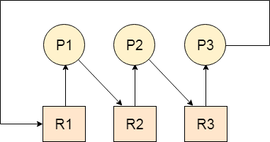

Slide 128
Difference between Starvation and Deadlock
Sr. | Deadlock | Starvation
1 | Deadlock is a situation where no process got blocked and no process proceeds | Starvation is a situation where the low priority process got blocked and the high priority processes proceed.
2 | Deadlock is an infinite waiting. | Starvation is a long waiting but not infinite.
3 | Every Deadlock is always a starvation. | Every starvation need not be deadlock.
4 | The requested resource is blocked by the other process. | The requested resource is continuously be used by the higher priority processes.
5 | Deadlock happens when Mutual exclusion, hold and wait, No preemption and circular wait occurs simultaneously. | It occurs due to the uncontrolled priority and resource management.

Slide 129
Necessary conditions for Deadlocks
Mutual Exclusion
A resource can only be shared in mutually exclusive manner. It implies, two process cannot use the same resource at the same time.
Hold and Wait
A process waits for some resources while holding another resource at the
same time.
No preemption
The process which once scheduled will be executed till the completion. No other process can be scheduled by the scheduler meanwhile.
Circular Wait
All the processes must be waiting for the resources in a cyclic manner so that the last process is waiting for the resource which is being held by the first process.

Slide 130
Strategies for handling Deadlock
1. Deadlock Ignorance
Deadlock Ignorance is the most widely used approach among all the mechanism. This is being used by many operating systems mainly for end user uses. In this approach, the Operating system assumes that deadlock never occurs. It simply ignores deadlock. This approach is best suitable for a single end user system where User uses the system only for browsing and all other normal stuff.
There is always a tradeoff between Correctness and performance. The operating systems like Windows and Linux mainly focus upon performance. However, the performance of the system decreases if it uses deadlock handling mechanism all the time if deadlock happens 1 out of 100 times then it is completely unnecessary to use the deadlock handling mechanism all the time.
In these types of systems, the user has to simply restart the computer in the case of deadlock. Windows and Linux are mainly using this approach.

Slide 131
Deadlock prevention
Deadlock happens only when Mutual Exclusion, hold and wait, No preemption and circular wait holds simultaneously. If it is possible to violate one of the four conditions at any time then the deadlock can never occur in the system.
The idea behind the approach is very simple that we have to fail one of the four conditions but there can be a big argument on its physical implementation in the system.
We will discuss it later in detail.
Deadlock avoidance
In deadlock avoidance, the operating system checks whether the system is in safe state or in unsafe state at every step which the operating system performs. The process continues until the system is in safe state. Once the system moves to unsafe state, the OS has to backtrack one step.
In simple words, The OS reviews each allocation so that the allocation doesn't cause the deadlock in the system.
Deadlock detection and recovery
This approach let the processes fall in deadlock and then periodically check whether deadlock occur in the system or not. If it occurs then it applies some of the recovery methods to the system to get rid of deadlock.
We will discuss deadlock detection and recovery later in more detail since it is a matter of discussion.

Slide 132
Deadlock Prevention
If we simulate deadlock with a table which is standing on its four legs then we can also simulate four legs with the four conditions which when occurs simultaneously, cause the deadlock.
However, if we break one of the legs of the table then the table will fall definitely. The same happens with deadlock, if we can be able to violate one of the four necessary conditions and don't let them occur together then we can prevent the deadlock.
Let's see how we can prevent each of the conditions.
1. Mutual Exclusion
Mutual section from the resource point of view is the fact that a resource can never be used by more than one process simultaneously which is fair enough but that is the main reason behind the deadlock. If a resource could have been used by more than one process at the same time then the process would have never been waiting for any resource.
However, if we can be able to violate resources behaving in the mutually exclusive
manner then the deadlock can be prevented.
Spooling
For a device like printer, spooling can work. There is a memory associated with the printer which stores jobs from each of the process into it. Later, Printer collects all the jobs and print each one of them according to FCFS. By using this mechanism, the process doesn't have to wait for the printer and it can continue whatever it was doing. Later, it collects the output when it is produced.

Slide 133
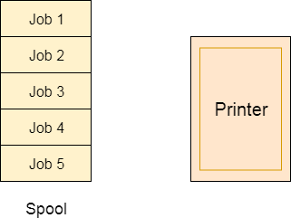
Although, Spooling can be an effective approach to violate mutual exclusion but it
suffers from two kinds of problems.
This cannot be applied to every resource.
After some point of time, there may arise a race condition between the processes to
get space in that spool.
We cannot force a resource to be used by more than one process at the same time since it will not be fair enough and some serious problems may arise in the performance. Therefore, we cannot violate mutual exclusion for a process practically.

Slide 134
2. Hold and Wait
Hold and wait condition lies when a process holds a resource and waiting for some other resource to complete its task. Deadlock occurs because there can be more than one process which are holding one resource and waiting for other in the cyclic order.
However, we have to find out some mechanism by which a process either doesn't hold any resource or doesn't wait. That means, a process must be assigned all the necessary resources before the execution starts. A process must not wait for any resource once the execution has been started.
!(Hold and wait) = !hold or !wait (negation of hold and wait is, either you don't hold or you don't wait)
This can be implemented practically if a process declares all the resources initially. However, this sounds very practical but can't be done in the computer system because a process can't determine necessary resources initially.
Process is the set of instructions which are executed by the CPU. Each of the instruction may demand multiple resources at the multiple times. The need cannot be fixed by the OS.
The problem with the approach is:
Practically not possible.
Possibility of getting starved will be increased due to the fact that some process may hold a resource for a very long time.

Slide 135
No Preemption
Deadlock arises due to the fact that a process can't be stopped once it starts. However, if we take the resource away from the process which is causing deadlock then we can prevent deadlock.
This is not a good approach at all since if we take a resource away which is being used by the process then all the work which it has done till now can become inconsistent.
Consider a printer is being used by any process. If we take the printer away from that process and assign it to some other process then all the data which has been printed can become inconsistent and ineffective and also the fact that the process can't start printing again from where it has left which causes performance inefficiency.
Circular Wait
To violate circular wait, we can assign a priority number to each of the resource. A process can't request for a lesser priority resource. This ensures that not a single process can request a resource which is being utilized by some other process and no cycle will be formed.

Slide 136
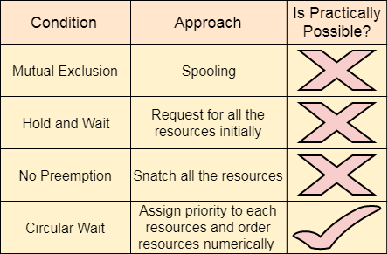
Among all the methods, violating Circular wait is the only approach that can be implemented practically.

Slide 137
Deadlock avoidance
In deadlock avoidance, the request for any resource will be granted if the resulting state of the system doesn't cause deadlock in the system. The state of the system will continuously be checked for safe and unsafe states.
In order to avoid deadlocks, the process must tell OS, the maximum number of
resources a process can request to complete its execution.
The simplest and most useful approach states that the process should declare the maximum number of resources of each type it may ever need. The Deadlock avoidance algorithm examines the resource allocations so that there can never be a circular wait condition.
Safe and Unsafe States
The resource allocation state of a system can be defined by the instances of available and allocated resources, and the maximum instance of the resources demanded by the processes.
A state of a system recorded at some random time is shown below.

Slide 138
Resources still needed
Resources Assigned
Process | Type 1 | Type 2 | Type 3 | Type 4
A | 3 | 0 | 2 | 2
B | 0 | 0 | 1 | 1
C | 1 | 1 | 1 | 0
D | 2 | 1 | 4 | 0
Process | Type 1 | Type 2 | Type 3 | Type 4
A | 1 | 1 | 0 | 0
B | 0 | 1 | 1 | 2
C | 1 | 2 | 1 | 0
D | 2 | 1 | 1 | 2
Above tables and vector E, P and A describes the resource allocation state of a system. There are 4 processes and 4 types of the resources in a system. Table 1 shows the instances of each resource assigned to each process.
E = (7 6 8 4)
P = (6 2 8 3)
A = (1 4 0 1)

Slide 139
Table 2 shows the instances of the resources, each process still needs. Vector E is the representation of total instances of each resource in the system.
Vector P represents the instances of resources that have been assigned to processes.
Vector A represents the number of resources that are not in use.
A state of the system is called safe if the system can allocate all the resources
requested by all the processes without entering into deadlock.
If the system cannot fulfill the request of all processes then the state of the system is
called unsafe.
The key of Deadlock avoidance approach is when the request is made for resources
then the request must only be approved in the case if the resulting state is also a safe
state.
Resource Allocation Graph
The resource allocation graph is the pictorial representation of the state of a system. As its name suggests, the resource allocation graph is the complete information about all the processes which are holding some resources or waiting for some resources.
It also contains the information about all the instances of all the resources whether
they are available or being used by the processes.
In Resource allocation graph, the process is represented by a Circle while the Resource is represented by a rectangle. Let's see the types of vertices and edges in detail.

Slide 140
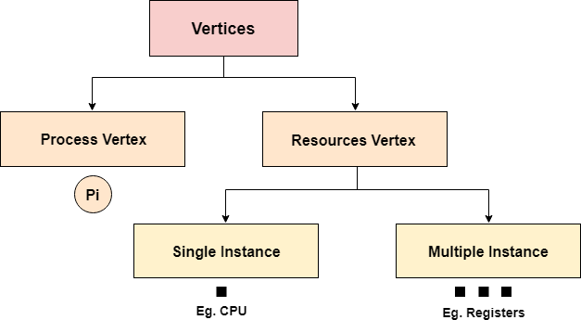
Vertices are mainly of two types, Resource and process. Each of them will be represented by a different shape. Circle represents process while rectangle represents resource.
A resource can have more than one instance. Each instance will be represented by a
dot inside the rectangle.

Slide 141
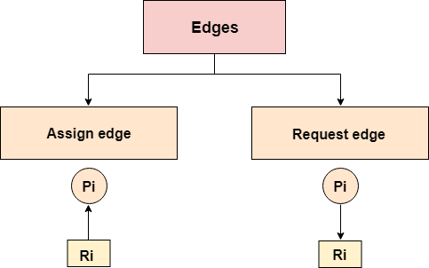
Edges in RAG are also of two types, one represents assignment and other represents the wait of a process for a resource. The above image shows each of them.
A resource is shown as assigned to a process if the tail of the arrow is attached to
an instance to the resource and the head is attached to a process.
A process is shown as waiting for a resource if the tail of an arrow is attached to
the process while the head is pointing towards the resource.

Slide 142
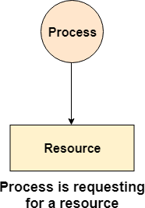
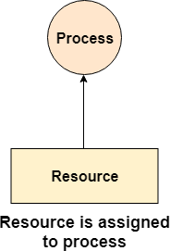
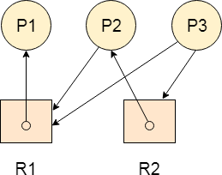
Example
Let's consider 3 processes P1, P2 and P3, and two types of resources R1 and R2. The resources are having 1 instance each.
According to the graph, R1 is being used by P1, P2 is holding R2 and waiting for R1, P3 is waiting for R1 as well as R2.
The graph is deadlock free since no cycle is being
formed in the graph.

Slide 143
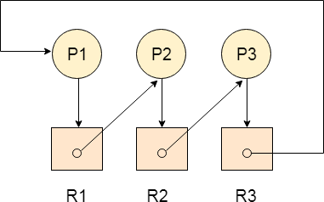
Deadlock Detection using RAG
If a cycle is being formed in a Resource allocation graph where all the resources have
the single instance then the system is deadlocked.
In Case of Resource allocation graph with multi-instanced resource types, Cycle is a necessary condition of deadlock but not the sufficient condition.
The following example contains three processes P1, P2, P3 and three resources R2, R2,
R3. All the resources are having single instances each.
If we analyze the graph then we can find out that there is a cycle formed in the graph since the system is satisfying all the four conditions of deadlock.

Slide 144
Allocation Matrix
Allocation matrix can be formed by using the Resource allocation graph of a system. In Allocation matrix, an entry will be made for each of the resource assigned. For Example, in the following matrix, en entry is being made in front of P1 and below R3 since R3 is assigned to P1.
Process | R1 | R2 | R3
P1 | 0 | 0 | 1
P2 | 1 | 0 | 0
P3 | 0 | 1 | 0
Request Matrix
In request matrix, an entry will be made for each of the resource requested. As in the following example, P1 needs R1 therefore an entry is being made in front of P1 and below R1.
Process | R1 | R2 | R3
P1 | 1 | 0 | 0
P2 | 0 | 1 | 0
P3 | 0 | 0 | 1
Avial = (0,0,0)
Neither we are having any resource available in the system nor a process going to release. Each of the process needs at least single resource to complete therefore they will continuously be holding each one of them.
We cannot fulfill the demand of at least one process using the available resources therefore the system is
deadlocked as determined earlier when we detected a cycle in the graph.

Slide 145
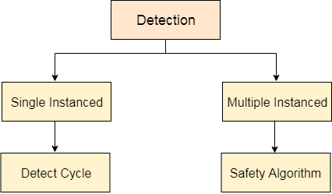
Deadlock Detection and Recovery
In this approach, The OS doesn't apply any mechanism to avoid or prevent the deadlocks. Therefore the system considers that the deadlock will definitely occur. In order to get rid of deadlocks, The OS periodically checks the system for any deadlock. In case, it finds any of the deadlock then the OS will recover the system using some recovery techniques.
The main task of the OS is detecting the deadlocks. The OS can detect the deadlocks
with the help of Resource allocation graph.
In single instanced resource types, if a cycle is being formed in the system then there will definitely be a deadlock. On the other hand, in multiple instanced resource type graph, detecting a cycle is not just enough. We have to apply the safety algorithm on the system by converting the resource allocation graph into the allocation matrix and request matrix.
In order to recover the system from deadlocks, either OS considers resources or
processes.

Slide 146
For Resource
Preempt the resource
We can snatch one of the resources from the owner of the resource (process) and give it to the other process with the expectation that it will complete the execution and will release this resource sooner. Well, choosing a resource which will be snatched is going to be a bit difficult.
Rollback to a safe state
System passes through various states to get into the deadlock state. The operating system can rollback the system to the previous safe state. For this purpose, OS needs to implement check pointing at every state.
The moment, we get into deadlock, we will rollback all the allocations to get
into the previous safe state.
For Process
Kill a process
Killing a process can solve our problem but the bigger concern is to decide which process to kill. Generally, Operating system kills a process which has done least amount of work until now.
Kill all process
This is not a suggestible approach but can be implemented if the problem becomes very serious. Killing all process will lead to inefficiency in the system because all the processes will execute again from starting.

Slide 147
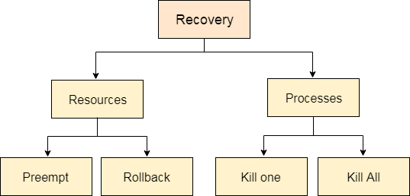

Slide 148
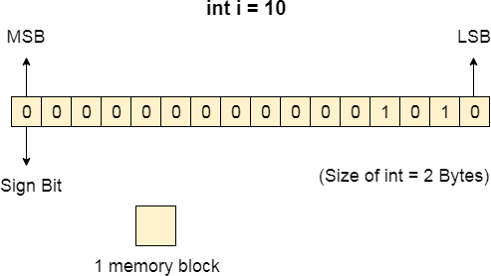
What is Memory?
Computer memory can be defined as a collection of some data represented in the binary format. On the basis of various functions, memory can be classified into various categories. We will discuss each one of them later in detail.
A computer device that is capable to store any information or data temporally or
permanently, is called storage device.
How Data is being stored in a computer system?
In order to understand memory management, we have to make everything clear about how data is being stored in a computer system.
Machine understands only binary language that is 0 or 1. Computer converts every
data into binary language first and then stores it into the memory.
That means if we have a program line written as int α = 10 then the computer
converts it into the binary language and then store it into the memory blocks.
The representation of int i = 10 is shown below.

Slide 149
The binary representation of 10 is 1010. Here, we are considering 32 bit system therefore, the size of int is 2 bytes i.e. 16 bit. 1 memory block stores 1 bit. If we are using signed integer then the most significant bit in the memory array is always a signed bit.
Signed bit value 0 represents positive integer while 1 represents negative integer.
Here, the range of values that can be stored using the memory array is -32768 to
+32767.
well, we can enlarge this range by using unsigned int. in that case, the bit which is now storing the sign will also store the bit value and therefore the range will be 0 to 65,535.
Need for Multi programming
However, The CPU can directly access the main memory, Registers and cache of the system. The program always executes in main memory. The size of main memory affects degree of Multi programming to most of the extent. If the size of the main memory is larger than CPU can load more processes in the main memory at the same time and therefore will increase degree of Multi programming as well as CPU utilization.

Slide 150
Let's consider, Process Size = 4 MB
Main memory size = 4 MB
The process can only reside in the main memory at any time. If the time for which the process does IO is P,
Then,
CPU utilization = (1-P) let's say,
P = 70%
CPU utilization = 30 %
Now, increase the memory size, Let's say it is 8 MB.
Process Size = 4 MB
Two processes can reside in the main memory at the same time.
Let's say the time for which, one process does its IO is P,
Then
CPU utilization = (1-P^2) let's say P = 70 %
CPU utilization = (1-0.49) =0.51 = 51 %
Therefore, we can state that the CPU utilization will be increased if the memory size gets increased.

Slide 151
Fixed Partitioning
The earliest and one of the simplest technique which can be used to load more than one processes into the main memory is Fixed partitioning or Contiguous memory allocation. In this technique, the main memory is divided into partitions of equal or different sizes.
The operating system always resides in the first partition while the other partitions can be used to store user processes. The memory is assigned to the processes in contiguous way.
In fixed partitioning,
The partitions cannot overlap.
A process must be contiguously present in a partition for the execution. There are various cons of using this technique.
1. Internal Fragmentation
If the size of the process is lesser then the total size of the partition then some size of the partition get wasted and remain unused. This is wastage of the memory and called internal fragmentation.
As shown in the image below, the 4 MB partition is used to load only 3 MB process
and the remaining 1 MB got wasted.

Slide 152
External Fragmentation
The total unused space of various partitions cannot be used to load the processes even
though there is space available but not in the contiguous form.
As shown in the image below, the remaining 1 MB space of each partition cannot be used as a unit to store a 4 MB process. Despite of the fact that the sufficient space is available to load the process, process will not be loaded.
Limitation on the size of the process
If the process size is larger than the size of maximum sized partition then that process cannot be loaded into the memory. Therefore, a limitation can be imposed on the process size that is it cannot be larger than the size of the largest partition.
Degree of multiprogramming is less
By Degree of multi programming, we simply mean the maximum number of processes that can be loaded into the memory at the same time. In fixed partitioning, the degree of multiprogramming is fixed and very less due to the fact that the size of the partition cannot be varied according to the size of processes.

Slide 153
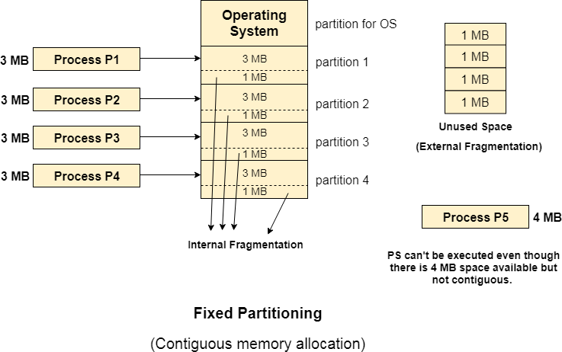

Slide 154
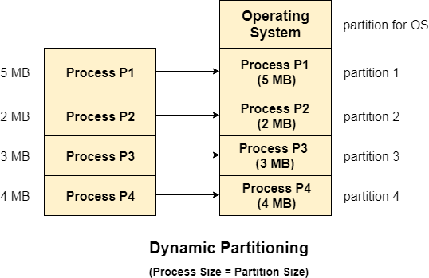
Dynamic Partitioning
Dynamic partitioning tries to overcome the problems caused by fixed partitioning. In this technique, the partition size is not declared initially. It is declared at the time of process loading.
The first partition is reserved for the operating system. The remaining space is divided into parts. The size of each partition will be equal to the size of the process. The partition size varies according to the need of the process so that the internal fragmentation can be avoided.

Slide 155
Advantages of Dynamic Partitioning over fixed partitioning
No Internal Fragmentation
Given the fact that the partitions in dynamic partitioning are created according to the need of the process, It is clear that there will not be any internal fragmentation because there will not be any unused remaining space in the partition.
No Limitation on the size of the process
In Fixed partitioning, the process with the size greater than the size of the largest partition could not be executed due to the lack of sufficient contiguous memory. Here, In Dynamic partitioning, the process size can't be restricted since the partition size is decided according to the process size.
Degree of multiprogramming is dynamic
Due to the absence of internal fragmentation, there will not be any unused space in
the partition hence more processes can be loaded in the memory at the same time.

Slide 156
Disadvantages of dynamic partitioning
External Fragmentation
Absence of internal fragmentation doesn't mean that there will not be external fragmentation.
Let's consider three processes P1 (1 MB) and P2 (3 MB) and P3 (1 MB) are being
loaded in the respective partitions of the main memory.
After some time P1 and P3 got completed and their assigned space is freed. Now there are two unused partitions (1 MB and 1 MB) available in the main memory but they cannot be used to load a 2 MB process in the memory since they are not contiguously located.
The rule says that the process must be contiguously present in the main memory to get
executed. We need to change this rule to avoid external fragmentation.

Slide 157
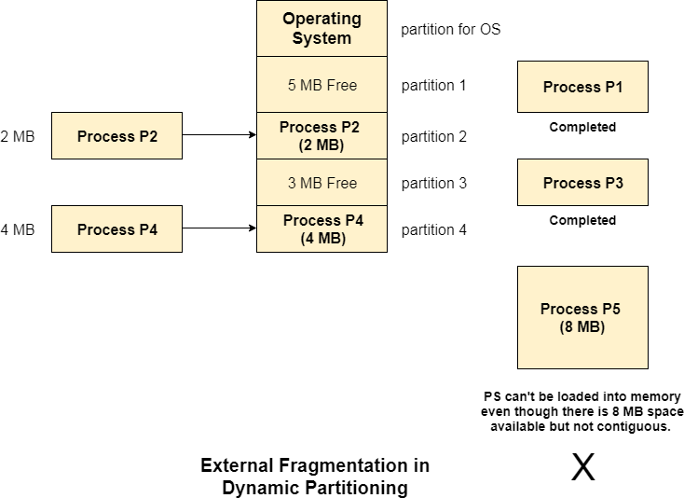

Slide 158
Complex Memory Allocation
In Fixed partitioning, the list of partitions is made once and will never change but in dynamic partitioning, the allocation and deallocation is very complex since the partition size will be varied every time when it is assigned to a new process. OS has to keep track of all the partitions.
Due to the fact that the allocation and deallocation are done very frequently in dynamic memory allocation and the partition size will be changed at each time, it is going to be very difficult for OS to manage everything.
Compaction
We got to know that the dynamic partitioning suffers from external fragmentation.
However, this can cause some serious problems.
To avoid compaction, we need to change the rule which says that the process can't be
stored in the different places in the memory.
We can also use compaction to minimize the probability of external fragmentation. In compaction, all the free partitions are made contiguous and all the loaded partitions are brought together.
By applying this technique, we can store the bigger processes in the memory. The free partitions are merged which can now be allocated according to the needs of new processes. This technique is also called defragmentation.

Slide 159
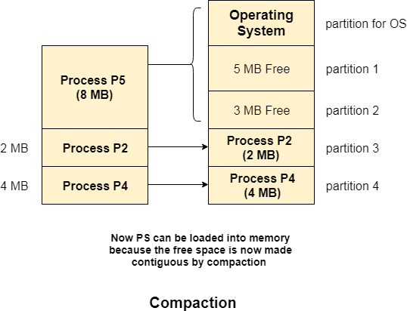

Slide 160
As shown in the image above, the process P5, which could not be loaded into the memory due to the lack of contiguous space, can be loaded now in the memory since the free partitions are made contiguous.
Problem with Compaction
The efficiency of the system is decreased in the case of compaction due to the fact that all the free spaces will be transferred from several places to a single place.
Huge amount of time is invested for this procedure and the CPU will remain idle for all this time. Despite of the fact that the compaction avoids external fragmentation, it makes system inefficient.
Let us consider that OS needs 6 NS to copy 1 byte from one place to another.
1 B transfer needs 6 NS
256 MB transfer needs 256 X 2^20 X 6 X 10 ^ -9 secs
hence, it is proved to some extent that the larger size memory transfer needs
some huge amount of time that is in seconds.

Slide 161
Bit Map for Dynamic Partitioning
The Main concern for dynamic partitioning is keeping track of all the free and allocated partitions. However, the
Operating system uses following data structures for this task.
Bit Map
Linked List
Bit Map is a data structure to store the details about allocation and reallocation of process. For this purpose the main memory is divided into the number of allocation units. One or more allocation units may assign to single process according to the need of that process. Size of each allocation unit is same which is fix by OS, that never changed. Although, the partition size from process to process may vary due to dynamic partitioning.
The main task of OS is to check whether the partitions are filled or free. For this purpose, flag bits are used. either process or hole in Allocation memory is represented by a flag bit of bitmap. 0 represents Hole and 1 represents the Process in bit map.
Let’s explain Bit Map in Dynamic Partitioning with Example
Suppose we have a main memory of 7 Byte. Where 2Byte is allocated to process 1, 3Bytes are allocated to Process 2 and 2 byte allocated to Process 3. After some time Process 2 complete its execution which create a hole of 3 byte in main memory shown in below diagram.

Slide 162
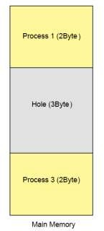
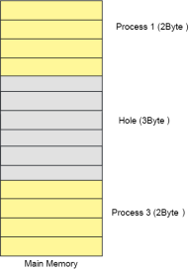
Let’s divide the main memory in allocation units and size of each allocation unit is fix to 4- bit (1/2Byte). As size of allocation unit is Half Byte then Process 1 will occupy 4 allocation units because of 2Byte Memory size and in the same way Process 2 will contains 6 allocation units as shown in below diagram.
To keep track allocated and holes OS use Bit map data
structure in main memory. Bit map contains either value 1 or
0. Total No of bits in bit map will always equal to Total No of Allocation units in main memory. In using diagram 14 allocation units are required to represent 7-Byte memory So,
14 bits are required for bit map. Each allocation unit is represented by 1-bit of bit-map data structure as shown in the following diagram. Corresponding bit for process is 1 and for hole is 0.

Slide 163


Assume a process 4 of size 1Byte wants to load in main memory then OS will scan the Bit map and search the contagious number of Zero’s. If space is available then that process will load successfully. So P4 will load successfully and its corresponding bits turns to 1 as shown in below diagram.
At this point suppose Process 3 is complete then its corresponding bits in bit-Map turn to 0 as explain in the following diagram.

Slide 164

Conclusion:
When a process complete
it execution
period, then its memory becomes free available which is a de-allocation method. And all its corresponding bits in bit-Map turns to Zero.
when a process load in main memory then its corresponding bits in bit-Map turns to 1 which is a allocation method.
Disadvantages of Using Bitmap
1. The OS has to assign some memory for bitmap to store the details about allocation and de-allocation.
Smaller the size of allocation unit more will be the memory required for Bit-Map. Explained Under
if Size of 1 allocation unit = 4 bits (1/2 Byte) then Size of bitmap = total main memory/ (size of allocation unit in bit + bit required for bit-map) = 1/(4+1)= 1/5 of total main memory.
If Size of 1 allocation unit = 8 bits (1 Byte) Size of bitmap = total main memory/ (size of allocation unit in bit + bit required
for bit-map) = 1/ (8+1) = 1/9 of total main memory.
If we increase the size of allocation unit then size of bit-map will reduced but some space may waste as given below in diagram. Because, two processes cannot exist in one allocation unit at a time, but one process can exist in more than one contiguous allocation units.

Slide 165

2. To find any hole in the memory, the OS has to search for 0s in the bitmap. This searching takes a lot of time which makes the system inefficient.

Slide 166
Linked List for Dynamic Partitioning
The better and the most popular approach to keep track of the free or filled
partitions is using Linked List.
In this approach, the Operating system maintains a linked list where each node represents each partition. Every node has three fields.
First field of the node stores a flag bit which shows whether the partition is a hole
or some process is inside.
Second field stores the starting index of the partition.
Third filed stores the end index of the partition.
If a partition is freed at some point of time then that partition will be merged with its adjacent free partition without doing any extra effort.
There are some points which need to be focused while using this approach.
The OS must be very clear about the location of the new node which is to be added in the linked list. However, adding the node according to the increasing order of starting index is suggestible.
Using a doubly linked list will make some positive effects on the performance due to the fact that a node in the doubly link list can also keep track of its previous node.

Slide 167


Slide 168

Types of Linked list In Dynamic Partitioning
1. Single Link List
Single link list, traverse only in forward direction. It can detect only holes or
process but cannot merge the adjacent holes.

Slide 169

2. Double Link List
Double link list, traverse in both forward and backward directions. It can detect holes and can merge the adjacent partitions of holes as well.
Advantages of double linked list over single link list Reduce the No. of partitions will increase the programming.
degree of multi-

Slide 170
Partitioning Algorithms
There are various algorithms which are implemented by the Operating System in
order to find out the holes in the linked list and allocate them to the processes. The explanation about each of the algorithm is given below.
1. First Fit Algorithm
First Fit algorithm scans the linked list and whenever it finds the first big enough hole to store a process, it stops scanning and load the process into that hole. This procedure produces two partitions. Out of them, one partition will be a hole while the other partition will store the process.
First Fit algorithm maintains the linked list according to the increasing order of starting index. This is the simplest to implement among all the algorithms and produces bigger holes as compare to the other algorithms.

Slide 171


Slide 172
Working Example for First Fit
Example: As shown on the right/below image Memory blocks available are : {100, 50, 30, 120, 35} Process P1, size: 20
OS Searches memory from sequentially from starting Block 1 fits, P1 gets assigned to block 1
Process P2, size: 60
OS Searches memory sequentially from block 1 again
Block 1 is unavailable, Block 2 and 3 can’t fit Block 4 fits, p2 assigned to block 4
Process P3, size: 70
OS Searches memory sequentially from block 1 again
Block 1 is unavailable, Block 2, 3 can’t fit. Block 4 unavailable, Block 5 can’t fit
P3 remains unallocated
Similarly, P4 is assigned to block 2
Advantages
Easy to implement
OS can allocate processes quickly as algorithm to allocate processes will be
quick as compared to other methods (Best Fit, Worst Fit, Next Fit etc) Disadvantages
Causes huge internal fragmentation
Smarter allocation may be done by best-fit algorithm
High chances of unallocated for some processes due to poor algorithm
More overhead as compared to next fit

Slide 173

2. Next Fit Algorithm
Next fit is another version of First Fit in which memory is searched for empty spaces similar to the first fit memory allocation scheme. Unlike first-fit memory allocation, the only difference between the two is, in the case of next fit, if the search is interrupted in between, the new search is carried out from the last location.
Next fit can also be said as the modified version of the first fit as it starts searching for a free memory as following the first-fit memory allocation scheme. This memory allocation scheme uses a moving pointer which moves along the empty memory slots to search memory for the next fit. The next fit memory allocation method avoids memory allocation always from the beginning of the memory space. The operating system uses a memory allocation algorithm, also known as the scheduling algorithm for this purpose.

Slide 174
Algorithm for memory allocation using Next Fit Step 1. Enter the number of memory blocks.
Step 2. Enter the size of each memory block.
Step 3. Enter the number of processes with their sizes.
Step 4. Start by selecting each process to check if it can be assigned to the current
memory block.
Step 5. If the condition in step 4 is true, then allocate the process with the required memory and check for the next process from the memory block where the searching was halted, not from the starting.
Step 6. If the current memory size is smaller, then continue to check the next blocks.
Step 7. Stop

Slide 175


Slide 176
Best Fit Algorithm
In the case of the best fit memory allocation scheme, the operating system searches for the empty memory block. When the operating system finds the memory block with minimum wastage of memory, it is allocated to the process this is known as Best Fit Algorithm in Operating System.
How does it work?
In Best fit memory allocation scheme, the operating system searches that can –
Accommodate the process
Also, leaves the minimum memory wastage
Example –
If you see the image below/right you will see that the process size is 40.
While blocks 1, 2 and 4 can accommodate the process. Block 2 is chosen as it
leaves the lowest memory wastage
Advantage:
It is allocated to the process. This scheme is considered the best approach
as it results in the most optimized memory allocation.
Also reduces internal fragmentation.
Disadvantage:
However, finding the best fit memory allocation may be time-consuming.

Slide 177


Slide 178
Worst Fit Algorithm in Operating System
The processes need empty memory slots during processing time. This memory is allocated to the processes by the operating system which decides depending on the free memory and the demanded memory by the process in execution. The three most common memory allocation schemes are first fit, best fit, and worst fit algorithm in Operating System.
How Worst Fit Works?
Worst fit works in the following way, for any given process P_{n}.
The algorithms searches sequentially starting from first memory block and searches
for the memory block that fulfills the following condition –
Can accommodate the process size
Leaves the largest wasted space (fragmentation) after the process is allocated to
given memory block

Slide 179


Slide 180


Slide 181
Algorithm for Worst Fit Memory Management Scheme
Step 1: Input memory block with a size.
Step 2: Input process with size.
Step 3: Initialize by selecting each process to find the maximum block size that can be assigned to the current process.
Step 4: If the condition does not fulfill, they leave the process.
Step 5: If the condition is not fulfilled, then leave the process and check for the next
process.
Step 6: Stop.
5. Quick Fit Algorithm
The quick fit algorithm suggests maintaining the different lists of frequently used sizes. Although, it is not practically suggestible because the procedure takes so much time to create the different lists and then expending the holes to load a process.
The first fit algorithm is the best algorithm among all because
It takes lesser time compare to the other algorithms.
It produces bigger holes that can be used to load other processes later on.
It is easiest to implement.

Slide 182

GATE question on best fit and first fit
From the GATE point of view, Numerical on best fit and first fit are being asked
frequently in 1 mark. Let's have a look on the one given as below.
Q. Process requests are given as;
25 K , 50 K , 100 K , 75 K
Determine the algorithm which can optimally satisfy this requirement.
First Fit algorithm
Best Fit Algorithm
Neither of the two
Both of them
In the question, there are five partitions in the memory. 3 partitions are having
processes inside them and two partitions are holes.

Slide 183


Using First Fit algorithm
Our task is to check the algorithm which can satisfy the request optimally.
Let's see, how first fit algorithm works on this problem.
1. 25 K requirement
The algorithm scans the list until it gets first hole which should be big enough to satisfy the request of 25 K. it gets the space in the second partition which is free hence it allocates 25 K out of 75 K to the process and the remaining 50 K is produced as hole.
2. 50 K requirement
The 50 K requirement can be fulfilled by allocating the third partition which is 50 K in size to the process. No free space is produced as free space.

Slide 184


3. 100 K requirement
100 K requirement can be fulfilled by using the fifth partition of 175 K size. Out of 175 K,
100 K will be allocated and remaining 75 K will be there as a hole.
4. 75 K requirement
Since we are having a 75 K free partition hence we can allocate that much space to the process which is demanding just 75 K space.
Using first fit algorithm, we have fulfilled the entire request optimally and no
useless space is remaining.
Let's see, How Best Fit algorithm performs for the problem.

Slide 185

Using Best Fit Algorithm
1. 25 K requirement
To allocate 25 K space using best fit approach, need to scan the whole list and then we find that a 75 K partition is free and the smallest among all, which can accommodate the need of the process.
Therefore 25 K out of those 75 K free partition is allocated to the process and the
remaining 5o K is produced as a hole.
2. 50 K requirement
To satisfy this need, we will again scan the whole list and then find the 50 K space is free which the exact match of the need is. Therefore, it will be allocated for the process.

Slide 186


3. 100 K requirement
100 K need is close enough to the 175 K space. The algorithm scans the whole list
and then allocates 100 K out of 175 K from the 5th free partition.
4. 75 K requirement
75 K requirement will get the space of 75 K from the 6th free partition but the
algorithm will scan the whole list in the process of taking this decision.

Slide 187

By following both of the algorithms, we have noticed that both the algorithms perform similar to most of the extant in this case.
Both can satisfy the need of the processes but however, the best fit algorithm scans
the list again and again which takes lot of time.
Therefore, if you ask me that which algorithm performs in more optimal way then it
will be First Fit algorithm for sure.
Therefore, the answer in this case is A.

Slide 188
Need for Paging
Disadvantage of Dynamic Partitioning
The main disadvantage of Dynamic Partitioning is External fragmentation. Although, this can be removed by Compaction but as we have discussed earlier, the compaction makes the system inefficient.
We need to find out a mechanism which can load the processes in the partitions in a
more optimal way. Let us discuss a dynamic and flexible mechanism called paging.
Need for Paging
Lets consider a process P1 of size 2 MB and the main memory which is divided into three partitions. Out of the three partitions, two partitions are holes of size 1 MB each.
P1 needs 2 MB space in the main memory to be loaded. We have two holes of 1 MB
each but they are not contiguous.
Although, there is 2 MB space available in the main memory in the form of those holes but that remains useless until it become contiguous. This is a serious problem to address.
We need to have some kind of mechanism which can store one process at different
locations of the memory.
The Idea behind paging is to divide the process in pages so that, we can store them in
the memory at different holes.

Slide 189

In Operating Systems, Paging is a storage mechanism used to retrieve processes
from the secondary storage into the main memory in the form of pages.
The main idea behind the paging is to divide each process in the form of pages. The main memory will also be divided in the form of frames.
One page of the process is to be stored in one of the frames of the memory. The pages can be stored at the different locations of the memory but the priority is always to find the contiguous frames or holes.
Pages of the process are brought into the main memory only when they are
required otherwise they reside in the secondary storage.

Slide 190

Different operating system defines different frame sizes. The sizes of each frame must be equal. Considering the fact that the pages are mapped to the frames in Paging, page size needs to be as same as frame size.

Slide 191
Example
Let us consider the main memory size 16 Kb and Frame size is 1 KB therefore the main
memory will be divided into the collection of 16 frames of 1 KB each.
There are 4 processes in the system that is P1, P2, P3 and P4 of 4 KB each. Each process is divided into pages of 1 KB each so that one page can be stored in one frame.
Initially, all the frames are empty therefore pages of the processes will get stored in
the contiguous way.
Frames, pages and the mapping between the two is shown in the image below.

Slide 192


Slide 193

Let us consider that, P2 and P4 are moved to waiting state after some time. Now, 8 frames become empty and therefore other pages can be loaded in that empty place. The process P5 of size 8 KB (8 pages) is waiting inside the ready queue.
Given the fact that, we have 8 non contiguous frames available in the memory and paging provides the flexibility of storing the process at the different places. Therefore, we can load the pages of process P5 in the place of P2 and P4.

Slide 194
The purpose of Memory Management Unit (MMU) is to convert the logical address into the physical address. The logical address is the address generated by the CPU for every page while the physical address is the actual address of the frame where each page will be stored.
Memory Management Unit
When a page is to be accessed by the CPU by using the logical address, the operating system
needs to obtain the physical address to access that page physically.
The logical address has two parts. Page Number
Offset
Memory management unit of OS needs to convert the page number to the frame number.
Example
Considering the above image, let's say that the CPU demands 10th word of 4th page of process P3. Since the page number 4 of process P1 gets stored at frame number 9 therefore the 10th word of 9th frame will be returned as the physical address.
Basics of Binary Addresses
Computer system assigns the binary addresses to the memory locations. However, The system uses amount of bits to address a memory location.
Using 1 bit, we can address two memory locations. Using 2 bits we can address 4 and using 3 bits we can address 8
memory locations.
A pattern can be identified in the mapping between the number of bits in the address and the range of the memory locations.
We know,
2.Using 2 bits, we can represent 2^2 i.e. 4 memory locations. 3.Using 3 bits, we can represent 2^3 i.e. 8 memory locations. 4.Therefore, if we generalize this,
5.Using n bits, we can assign 2^n memory locations.
6.
7.n bits of address → 2 ^ n memory locations
1.Using 1 Bit we can represent 2^1 i.e 2 memory locations.

Slide 195


These n bits can be divided into two parts, that are, K bits and (n-k) bits.

Slide 196
Physical and Logical Address Space
Physical Address Space
Physical address space in a system can be defined as the size of the main memory. It is really important to compare the process size with the physical address space. The process size must be less than the physical address space.
Physical Address Space = Size of the Main Memory If, physical address space = 64 KB = 2 ^ 6 KB = 2 ^ 6 X 2 ^ 10 Bytes = 2 ^ 16 bytes Let us consider, word size = 8 Bytes = 2 ^ 3 Bytes Hence, Physical address space (in words) = (2 ^ 16) / (2 ^ 3) = 2 ^ 13 Words Therefore, Physical Address = 13 bits In General, If, Physical Address Space = N Words then, Physical Address = log₂ N

Slide 197
Logical Address Space
Logical address space can be defined as the size of the process. The size of the process should be less enough so that it can reside in the main memory.
Let's say,
Logical Address Space = 128 MB = (2 ^ 7 X 2 ^ 20) Bytes = 2 ^ 27 Bytes Word size = 4 Bytes = 2 ^ 2 Bytes Logical Address Space (in words) = (2 ^ 27) / (2 ^ 2) = 2 ^ 25 Words Logical Address = 25 Bits In general, If, logical address space = L words Then, Logical Address = Log₂L bits
What is a Word?
The Word is the smallest unit of the memory. It is the collection of bytes. Every operating system defines different word sizes after analyzing the n-bit address that is inputted to the decoder and the 2 ^ n memory locations that are produced from the decoder.

Slide 198
Page Table in OS
Page Table is a data structure used by the virtual memory system to store the mapping between logical addresses and physical addresses.
Logical addresses are generated by the CPU for the pages of the processes therefore they are generally used by the processes.
Physical addresses are the actual frame address of the memory. They are generally used by the hardware or more specifically by RAM subsystems.
The image given below considers,
Physical Address Space = M words Logical Address Space = L words Page Size = P words Physical Address = log ₂ M = m bits Logical Address = log ₂ L = l bits page offset = log ₂ P = p bits

Slide 199


Slide 200
The CPU always accesses the processes through their logical addresses. However, the main memory recognizes physical address only.
In this situation, a unit named as Memory Management Unit comes into the picture. It converts the page number of the logical address to the frame number of the physical address. The offset remains same in both the addresses.
To perform this task, Memory Management unit needs a special kind of mapping which is done by page table. The page table stores all the Frame numbers corresponding to the page numbers of the page table.
In other words, the page table maps the page number to its actual location (frame number) in the memory.
In the image given below shows, how the required word of the frame is accessed with the help of offset.

Slide 201


Slide 202
Mapping from page table to main memory
In operating systems, there is always a requirement of mapping from logical address to the physical address. However, this process involves various steps which are defined as follows.
1. Generation of logical address
CPU generates logical address for each page of the process. This contains two parts: page number and offset.
2. Scaling
To determine the actual page number of the process, CPU stores the page table base in a special register. Each time the address is generated, the value of the page table base is added to the page number to get the actual location of the page entry in the table. This process is called scaling.
3. Generation of physical Address
The frame number of the desired page is determined by its entry in the page table. A physical address is generated which also contains two parts : frame number and offset. The Offset will be similar to the offset of the logical address therefore it will be copied from the logical address.
4. Getting Actual Frame Number
The frame number and the offset from the physical address is mapped to the main memory in order to get the actual word address.

Slide 203


Slide 204
Page Table Entry
Along with page frame number, the page table also contains some of the bits representing the extra information regarding the page.
Let's see what the each bit represents about the page.
1. Caching Disabled
Sometimes, there are differences between the information closest to the CPU and the information closest to the user. Operating system always wants CPU to access user's data as soon as possible. CPU accesses cache which can be inaccurate in some of the cases, therefore, OS can disable the cache for the required pages. This bit is set to 1 if the cache is disabled.
2. Referenced
There are various page replacement algorithms which will be covered later in this tutorial. This bit is set to 1 if the page is referred in the last clock cycle otherwise it remains 0.
3. Modified
This bit will be set if the page has been modified otherwise it remains 0.
4. Protection
The protection field represents the protection level which is applied on the page. It can be read only or read & write or execute. We need to remember that it is not a bit rather it is a field which contains many bits.

Slide 205

5. Present/Absent
In the concept of demand paging, all the pages doesn't need to be present in the main memory Therefore, for all the pages that are present in the main memory, this bit will be set to 1 and the bit will be 0 for all the pages which are absent.
If some page is not present in the main memory then it is called page fault.
Size of the page table
However, the part of the process which is being executed by the CPU must be present in the main memory during that time period. The page table must also be present in the main memory all the time because it has the entry for all the pages.
The size of the page table depends upon the number of entries in the table and the bytes stored in one entry.
Let's consider,

Slide 206
Logical Address = 24 bits
Logical Address space = 2 ^ 24 bytes
Let's say, Page size = 4 KB = 2 ^ 12 Bytes
Page offset = 12
Number of bits in a page = Logical Address - Page Offset = 24 - 12 = 12 bits
Number of pages = 2 ^ 12 = 2 X 2 X 2 ^ 10 = 4 KB
Let's say, Page table entry = 1 Byte
Therefore, the size of the page table = 4 KB X 1 Byte = 4 KB
Here we are lucky enough to get the page table size equal to the frame size. Now, the page table will be simply stored in one of the frames of the main memory. The CPU maintains a register which contains the base address of that frame, every page number from the logical address will first be added to that base address so that we can access the actual location of the word being asked.
However, in some cases, the page table size and the frame size might not be same. In those cases, the page table is considered as the collection of frames and will be stored in the different frames.

Slide 207
Finding Optimal Page Size
We have seen that the bigger page table size cause an extra overhead because we have to divide that table into the pages and then store that into the main memory.
Our concern must be about executing processes not on the execution of page table. Page table provides a support for the execution of the process. The larger the page Table, the higher the overhead.
We know that,
Page Table Size = number of page entries in page table X size of one page entry
Let's consider an example,
Virtual Address Space = 2 GB = 2 X 2 ^ 30 Bytes
Page Size = 2 KB = 2 X 2 ^ 10 Bytes
Number of Pages in Page Table = (2 X 2 ^ 30)/(2 X 2 ^ 10) = 1 M pages
There will be 1 million pages which is quite big number. However, try to make page size larger, say 2 MB.
Then, Number of pages in page table = (2 X 2 ^ 30)/(2 X 2 ^ 20) = 1 K pages.
If we compare the two scenarios, we can find out that the page table size is anti proportional to Page Size.
In Paging, there is always wastage on the last page. If the virtual address space is not a multiple of page size, then there will be some bytes remaining and we have to assign a full page to those many bytes. This is simply a overhead.

Slide 208
Let's consider,
Page Size = 2 KB
Virtual Address Space = 17 KB
Then number of pages = 17 KB / 2 KB
The number of pages will be 9 although the 9th page will only contain 1 byte and the remaining page will be wasted.
In general,
If page size = p bytes
Entry size = e bytes
Virtual Address Space = S bytes
Then, overhead O = (S/p) X e + (p/2)
On an average, the wasted number of pages in a virtual space is p/2(the half of total number of pages).
For, the minimal overhead,
∂O/∂p = 0
-S/(p^2) + ½ = 0
p = √ (2.S.e) bytes
Hence, if the page size √(2.S.e) bytes then the overhead will be minimal.

Slide 209
What is Virtual Memory in OS (Operating System)?
Virtual Memory is a storage scheme that provides user an illusion of having a very big main memory. This is done by treating a part of secondary memory as the main memory.
In this scheme, User can load the bigger size processes than the available main memory by having the illusion that the memory is available to load the process.
Instead of loading one big process in the main memory, the Operating System loads the different parts of more than one process in the main memory.
By doing this, the degree of multiprogramming will be increased and therefore, the CPU utilization will also be increased.
How Virtual Memory Works?
In modern word, virtual memory has become quite common these days. In this scheme, whenever some pages needs to be loaded in the main memory for the execution and the memory is not available for those many pages, then in that case, instead of stopping the pages from entering in the main memory, the OS search for the RAM area that are least used in the recent times or that are not referenced and copy that into the secondary memory to make the space for the new pages in the main memory.
Since all this procedure happens automatically, therefore it makes the computer feel like it is having the unlimited RAM.

Slide 210
Demand Paging
Demand Paging is a popular method of virtual memory management. In demand paging, the pages of a process which are least used, get stored in the secondary memory.
A page is copied to the main memory when its demand is made or page fault occurs. There are various page replacement algorithms which are used to determine the pages which will be replaced. We will discuss each one of them later in detail.
Snapshot of a virtual memory management system
Let us assume 2 processes, P1 and P2, contains 4 pages each. Each page size is 1 KB. The main memory contains 8 frame of 1 KB each. The OS resides in the first two partitions. In the third partition, 1st page of P1 is stored and the other frames are also shown as filled with the different pages of processes in the main memory.
The page tables of both the pages are 1 KB size each and therefore they can be fit in one frame each. The page tables of both the processes contain various information that is also shown in the image.
The CPU contains a register which contains the base address of page table that is 5 in the case of P1 and 7 in the case of P2. This page table base address will be added to the page number of the Logical address when it comes to accessing the actual corresponding entry.

Slide 211


Slide 212
Advantages of Virtual Memory
The degree of Multiprogramming will be increased.
User can run large application with less real RAM.
There is no need to buy more memory RAMs.
Disadvantages of Virtual Memory
The system becomes slower since swapping takes time.
It takes more time in switching between applications.
The user will have the lesser hard disk space for its use.
Translation Look aside buffer
Drawbacks of Paging
Size of Page table can be very big and therefore it wastes main memory.
CPU will take more time to read a single word from the main memory.
How to decrease the page table size
The page table size can be decreased by increasing the page size but it will cause internal fragmentation and there will also be page wastage.
Other way is to use multilevel paging but that increases the effective access time therefore this is not a practical approach.
How to decrease the effective access time
CPU can use a register having the page table stored inside it so that the access time to access page table can become quite less but the register are not cheaper and they are very small in compare to the page table size therefore, this is also not a practical approach.
To overcome these many drawbacks in paging, we have to look for a memory that is cheaper than the register and faster than the main memory so that the time taken by the CPU to access page table again and again can be reduced and it can only focus to access the actual word.

Slide 213
Locality of reference
In operating systems, the concept of locality of reference states that, instead of loading the entire process in the main memory, OS can load only those number of pages in the main memory that are frequently accessed by the CPU and along with that, the OS can also load only those page table entries which are corresponding to those many pages.
Translation look aside buffer (TLB)
A Translation look aside buffer can be defined as a memory cache which can be used to reduce the time taken to access the page table again and again.
It is a memory cache which is closer to the CPU and the time taken by CPU to access TLB is lesser then that taken to access main memory.
In other words, we can say that TLB is faster and smaller than the main memory but cheaper and bigger than the register.
TLB follows the concept of locality of reference which means that it contains only the entries of those many pages that are frequently accessed by the CPU.

Slide 214

In translation look aside buffers, there are tags and keys with the help of which, the mapping is done.
TLB hit is a condition where the desired entry is found in translation look aside buffer. If this happens then the CPU simply access the actual location in the main memory.
However, if the entry is not found in TLB (TLB miss) then CPU has to access page table in the main memory and then access the actual frame in the main memory.
Therefore, in the case of TLB hit, the effective access time will be lesser as compare to the case of TLB miss.
If the probability of TLB hit is P% (TLB hit rate) then the probability of TLB miss (TLB miss rate) will be (1-P) %.

Slide 215
Therefore, the effective access time can be defined as;
EAT = P (t + m) + (1 - p) (t + k.m + m)
Where, p → TLB hit rate, t → time taken to access TLB, m → time taken to access main memory k = 1, if the single level paging has been implemented.
By the formula, we come to know that
Effective access time will be decreased if the TLB hit rate is increased.
Effective access time will be increased in the case of multilevel paging.
GATE | GATE-CS-2014-(Set-3)
Consider a paging hardware with a TLB. Assume that the entire page table and all the pages are in the physical memory. It takes 10 milliseconds to search the TLB and 80 milliseconds to access the physical memory. If the TLB hit ratio is 0.6, the effective memory access time (in milliseconds) is _________.
A. 120 B. 122 C. 124 D. 118
Given,
TLB hit ratio = 0.6
Therefore, TLB miss ratio = 0.4
Time taken to access TLB (t) = 10 ms
Time taken to access main memory (m) = 80 ms
Effective Access Time (EAT) = 0.6 ( 10 + 80 ) + 0.4 ( 10 + 80 + 80 ) = 90 X 0.6 + 0.4 X 170 = 122

Slide 216
What is Demand Paging in OS (Operating System)?
According to the concept of Virtual Memory, in order to execute some process, only a part of the process needs to be present in the main memory which means that only a few pages will only be present in the main memory at any time.
However, deciding, which pages need to be kept in the main memory and which need to be kept in the secondary memory, is going to be difficult because we cannot say in advance that a process will require a particular page at particular time.
Therefore, to overcome this problem, there is a concept called Demand Paging is introduced. It suggests keeping all pages of the frames in the secondary memory until they are required. In other words, it says that do not load any page in the main memory until it is required.
Whenever any page is referred for the first time in the main memory, then that page will be found in the secondary memory.
After that, it may or may not be present in the main memory depending upon the page replacement algorithm which will be covered later in this tutorial.

Slide 217
What is a Page Fault?
If the referred page is not present in the main memory then there will be a miss and the concept is called Page miss or page fault.
The CPU has to access the missed page from the secondary memory. If the number of page fault is very high then the effective access time of the system will become very high.
What is Thrashing?
If the number of page faults is equal to the number of referred pages or the number of page faults are so high so that the CPU remains busy in just reading the pages from the secondary memory then the effective access time will be the time taken by the CPU to read one word from the secondary memory and it will be so high. The concept is called thrashing.
If the page fault rate is PF %, the time taken in getting a page from the secondary memory and again restarting is S (service time) and the memory access time is ma then the effective access time can be given as;
EAT = PF X S + (1 - PF) X (ma)

Slide 218

Inverted Page Table
Inverted Page Table is the global page table which is maintained by the Operating System for all the processes. In inverted page table, the number of entries is equal to the number of frames in the main memory. It can be used to overcome the drawbacks of page table.
There is always a space reserved for the page regardless of the fact that whether it is present in the main memory or not. However, this is simply the wastage of the memory if the page is not present.
We can save this wastage by just inverting the page table. We can save the details only for the pages which are present in the main memory. Frames are the indices and the information saved inside the block will be Process ID and page number.

Slide 219

Page Replacement Algorithms in Operating Systems (OS)
Today we are going to learn about Page Replacement Algorithms in Operating Systems (OS). Before knowing about Page Replacement Algorithms in Operating Systems let us learn about Paging in Operating Systems and also a little about Virtual Memory.
Only after understanding the concept of Paging we will understand about Page Replacement Algorithms.
Paging in Operating Systems (OS)
Paging is a storage mechanism. Paging is used to retrieve processes from secondary memory to primary memory.
The main memory is divided into small blocks called pages. Now, each of the pages contains the process which is retrieved into main memory and it is stored in one frame of memory.
It is very important to have pages and frames which are of equal sizes which are very useful for mapping and complete utilization of memory.

Slide 220
Virtual Memory in Operating Systems (OS)
A storage method known as virtual memory gives the user the impression that their main memory is quite large. By considering a portion of secondary memory as the main memory, this is accomplished.
By giving the user the impression that there is memory available to load the process, this approach allows them to load larger size programs than the primary memory that is accessible.
The Operating System loads the many components of several processes in the main memory as opposed to loading a single large process there.
By doing this, the level of multiprogramming will be enhanced, which will increase CPU consumption.
Demand Paging
The Demand Paging is a condition which is occurred in the Virtual Memory. We know that the pages of the process are stored in secondary memory. The page is brought to the main memory when required. We do not know when this requirement is going to occur. So, the pages are brought to the main memory when required by the Page Replacement Algorithms.
So, the process of calling the pages to main memory from secondary memory upon demand is known as Demand Paging.

Slide 221

The important jobs of virtual memory in Operating Systems are two. They are:
Frame Allocation
Page Replacement.
Frame Allocation in Virtual Memory
Demand paging is used to implement virtual memory, an essential component of operating systems. A page-replacement mechanism and a frame allocation algorithm must be created for demand paging. If you have numerous processes, frame allocation techniques are utilized to determine how many frames to provide to each process.
A Physical Address is required by the Central Processing Unit (CPU) for the frame creation and the physical Addressing provides the actual address to the frame created. For each page a frame must be created.

Slide 222
Frame Allocation Constraints
The Frames that can be allocated cannot be greater than total number of frames.
Each process should be given a set minimum amount of frames.
When fewer frames are allocated then the page fault ratio increases and the process execution becomes less efficient
There ought to be sufficient frames to accommodate all the many pages that a single instruction may refer to
Frame Allocation Algorithms
There are three types of Frame Allocation Algorithms in Operating Systems. They are:
1) Equal Frame Allocation Algorithms
Here, in this Frame Allocation Algorithm we take number of frames and number of processes at once. We divide the number of frames by number of processes. We get the number of frames we must provide for each process.
AD
This means if we have 36 frames and 6 processes. For each process 6 frames are allocated.
It is not very logical to assign equal frames to all processes in systems with processes of different sizes. A lot of allocated but unused frames will eventually be wasted if a lot of frames are given to a little operation.
2) Proportionate Frame Allocation Algorithms
Here, in this Frame Allocation Algorithms we take number of frames based on the process size. For big process more number of frames is allocated. For small processes less number of frames is allocated by the operating system.
The problem in the Proportionate Frame Allocation Algorithm is number of frames are wasted in some rare cases.
AD
The advantage in Proportionate Frame Allocation Algorithm is that instead of equally, each operation divides the available frames according to its demands.

Slide 223
3) Priority Frame Allocation Algorithms
According to the quantity of frame allocations and the processes, priority frame allocation distributes frames. Let's say a process has a high priority and needs more frames; in such case, additional frames will be given to the process. Processes with lower priorities are then later executed in future and first only high priority processes are executed first.
Page Replacement Algorithms
There are three types of Page Replacement Algorithms. They are:
Optimal Page Replacement Algorithm
First In First Out Page Replacement Algorithm
Least Recently Used (LRU) Page Replacement Algorithm
First in First out Page Replacement Algorithm
This is the first basic algorithm of Page Replacement Algorithms. This algorithm is basically dependent on the number of frames used. Then each frame takes up the certain page and tries to access it. When the frames are filled then the actual problem starts. The fixed number of frames is filled up with the help of first frames present. This concept is fulfilled with the help of Demand Paging
After filling up of the frames, the next page in the waiting queue tries to enter the frame. If the frame is present then, no problem is occurred. Because of the page which is to be searched is already present in the allocated frames.

Slide 224
If the page to be searched is found among the frames then, this process is known as Page Hit.
If the page to be searched is not found among the frames then, this process is known as Page Fault.
When Page Fault occurs this problem arises, then the First In First Out Page Replacement Algorithm comes into picture.
The First In First Out (FIFO) Page Replacement Algorithm removes the Page in the frame which is allotted long back. This means the useless page which is in the frame for a longer time is removed and the new page which is in the ready queue and is ready to occupy the frame is allowed by the First In First Out Page Replacement.
Let us understand this First In First Out Page Replacement Algorithm working with the help of an example.
Example:
Consider the reference string 6, 1, 1, 2, 0, 3, 4, 6, 0, 2, 1, 2, 1, 2, 0, 3, 2, 1, 2, 0 for a memory with three frames and calculate number of page faults by using FIFO (First In First Out) Page replacement algorithms.
Points to Remember
Page Not Found - - - > Page Fault
Page Found - - - > Page Hit
Reference String:

Slide 225

Number of Page Hits = 8
Number of Page Faults = 12
The Ratio of Page Hit to the Page Fault = 8 : 12 - - - > 2 : 3 - - - > 0.66
The Page Hit Percentage = 8 *100 / 20 = 40%
The Page Fault Percentage = 100 - Page Hit Percentage = 100 - 40 = 60%
Explanation
First, fill the frames with the initial pages. Then, after the frames are filled we need to create a space in the frames for the new page to occupy. So, with the help of First in First Out Page Replacement Algorithm we remove the frame which contains the page is older among the pages. By removing the older page we give access for the new frame to occupy the empty space created by the First in First out Page Replacement Algorithm.

Slide 226
OPTIMAL Page Replacement Algorithm
This is the second basic algorithm of Page Replacement Algorithms. This algorithm is basically dependent on the number of frames used. Then each frame takes up the certain page and tries to access it. When the frames are filled then the actual problem starts. The fixed number of frames is filled up with the help of first frames present. This concept is fulfilled with the help of Demand Paging
After filling up of the frames, the next page in the waiting queue tries to enter the frame. If the frame is present then, no problem is occurred. Because of the page which is to be searched is already present in the allocated frames.
If the page to be searched is found among the frames then, this process is known as Page Hit.
If the page to be searched is not found among the frames then, this process is known as Page Fault.
When Page Fault occurs this problem arises, then the OPTIMAL Page Replacement Algorithm comes into picture.
The OPTIMAL Page Replacement Algorithms works on a certain principle. The principle is:
Replace the Page which is not used in the Longest Dimension of time in future
This principle means that after all the frames are filled then, see the future pages which are to occupy the frames. Go on checking for the pages which are already available in the frames. Choose the page which is at last.
Example:
Suppose the Reference String is:
0, 3, 4, 6, 0, 2, 1, 2, 1, 2, 0, 3, 2, 1, 2, 0
6, 1, 2 are in the frames occupying the frames.
Now we need to enter 0 into the frame by removing one page from the page
So, let us check which page number occurs last

Slide 227

From the sub sequence 0, 3, 4, 6, 0, 2, 1 we can say that 1 is the last occurring page number. So we can say that 0 can be placed in the frame body by removing 1 from the frame.
Let us understand this OPTIMAL Page Replacement Algorithm working with the help of an example.
Example:
Consider the reference string 6, 1, 1, 2, 0, 3, 4, 6, 0, 2, 1, 2, 1, 2, 0, 3, 2, 1, 4, 0 for a memory with three frames and calculate number of page faults by using OPTIMAL Page replacement algorithms.
Points to Remember
Page Not Found - - - > Page Fault
Page Found - - - > Page Hit
Reference String:
Number of Page Hits = 8
Number of Page Faults = 12
The Ratio of Page Hit to the Page Fault = 8 : 12 - - - > 2 : 3 - - - > 0.66
The Page Hit Percentage = 8 *100 / 20 = 40%
The Page Fault Percentage = 100 - Page Hit Percentage = 100 - 40 = 60%

Slide 228
Explanation
First, fill the frames with the initial pages. Then, after the frames are filled we need to create a space in the frames for the new page to occupy.
Here, we would fill the empty spaces with the pages we and the empty frames we have. The problem occurs when there is no space for occupying of pages. We have already known that we would replace the Page which is not used in the Longest Dimension of time in future.
There comes a question what if there is absence of page which is in the frame.
Suppose the Reference String is:
0, 2, 4, 6, 0, 2, 1, 2, 1, 2, 0, 3, 2, 1, 2, 0
6, 1, 5 are in the frames occupying the frames.
Here, we can see that page number 5 is not present in the Reference String. But the number 5 is present in the Frame. So, as the page number 5 is absent we remove it when required and other page can occupy that position.

Slide 229
Least Recently Used (LRU) Replacement Algorithm
This is the last basic algorithm of Page Replacement Algorithms. This algorithm is basically dependent on the number of frames used. Then each frame takes up the certain page and tries to access it. When the frames are filled then the actual problem starts. The fixed number of frames is filled up with the help of first frames present. This concept is fulfilled with the help of Demand Paging
After filling up of the frames, the next page in the waiting queue tries to enter the frame. If the frame is present then, no problem is occurred. Because of the page which is to be searched is already present in the allocated frames.
If the page to be searched is found among the frames then, this process is known as Page Hit.
If the page to be searched is not found among the frames then, this process is known as Page Fault.
When Page Fault occurs this problem arises, then the Least Recently Used (LRU) Page Replacement Algorithm comes into picture.
The Least Recently Used (LRU) Page Replacement Algorithms works on a certain principle. The principle is:
Replace the page with the page which is less dimension of time recently used page in the past.
Example:
Suppose the Reference String is: 6, 1, 1, 2, 0, 3, 4, 6, 0

Slide 230

The pages with page numbers 6, 1, 2 are in the frames occupying the frames.
Now, we need to allot a space for the page numbered 0.
Now, we need to travel back into the past to check which page can be replaced.
6 is the oldest page which is available in the Frame.
So, replace 6 with the page numbered 0.
Let us understand this Least Recently Used (LRU) Page Replacement Algorithm working with the help of an example.
Example:
Consider the reference string 6, 1, 1, 2, 0, 3, 4, 6, 0, 2, 1, 2, 1, 2, 0, 3, 2, 1, 2, 0 for a memory with three frames and calculate number of page faults by using Least Recently Used (LRU) Page replacement algorithms.
Points to Remember
Page Not Found - - - > Page Fault
Page Found - - - > Page Hit
Reference String:

Slide 231
Number of Page Hits = 7
Number of Page Faults = 13
The Ratio of Page Hit to the Page Fault = 7 : 12 - - - > 0.5833 : 1
The Page Hit Percentage = 7 * 100 / 20 = 35%
The Page Fault Percentage = 100 - Page Hit Percentage = 100 - 35 = 65%
Explanation
First, fill the frames with the initial pages. Then, after the frames are filled we need to create a space in the frames for the new page to occupy.
Here, we would fill the empty spaces with the pages we and the empty frames we have. The problem occurs when there is no space for occupying of pages. We have already known that we would replace the Page which is not used in the Longest Dimension of time in past or can be said as the Page which is very far away in the past.

Slide 232
Case 1: Number of frames = 3
Number of Page Faults = 9
Belady'sAnomaly
In the case of LRU and optimal page replacement algorithms, it is seen that the number of page faults will be reduced if we increase the number of frames. However, Balady found that, In FIFO page replacement algorithm, the number of page faults will get increased with the increment in number of frames.
This is the strange behavior shown by FIFO algorithm in some of the cases. This is an Anomaly called as Belady'sAnomaly.
Let's examine such example :
The reference String is given as 0 1 5 3 0 1 4 0 1 5 3 4. Let's analyze the behavior of FIFO algorithm in two cases.
Current TimeÂ 1:05
/
DurationÂ 18:10
Loaded: 11.74%
Â
Case 1: Number of frames = 3
Request | 0 | 1 | 5 | 3 | 0 | 1 | 4 | 0 | 1 | 5 | 3 | 4
Frame 3 |  |  | 5 | 5 | 5 | 1 | 1 | 1 | 1 | 1 | 3 | 3
Frame 2 |  | 1 | 1 | 1 | 0 | 0 | 0 | 0 | 0 | 5 | 5 | 5
Frame 1 | 0 | 0 | 0 | 3 | 3 | 3 | 4 | 4 | 4 | 4 | 4 | 4
Miss/Hit | Miss | Miss | Miss | Miss | Miss | Miss | Miss | Hit | Hit | Miss | Miss | Hit

Slide 233
Case 2: Number of frames = 4
Number of Page Faults = 10
Therefore, in this example, the number of page faults is increasing by increasing the number of frames hence this suffers from Belady'sAnomaly.
Case 2: Number of frames = 4
Request | 0 | 1 | 5 | 3 | 0 | 1 | 4 | 0 | 1 | 5 | 3 | 4
Frame 4 |  |  |  | 3 | 3 | 3 | 3 | 3 | 3 | 5 | 5 | 5
Frame 3 |  |  | 5 | 5 | 5 | 5 | 5 | 5 | 1 | 1 | 1 | 1
Frame 2 |  | 1 | 1 | 1 | 1 | 1 | 1 | 0 | 0 | 0 | 0 | 4
Frame 1 | 0 | 0 | 0 | 0 | 0 | 0 | 4 | 4 | 4 | 4 | 3 | 3
Miss/Hit | Miss | Miss | Miss | Miss | Hit | Hit | Miss | Miss | Miss | Miss | Miss | Miss

Slide 234
Segmentation in OS (Operating System)
In Operating Systems, Segmentation is a memory management technique in which the memory is divided into the variable size parts. Each part is known as a segment which can be allocated to a process.
The details about each segment are stored in a table called a segment table. Segment table is stored in one (or many) of the segments.
Segment table contains mainly two information about segment:
Base: It is the base address of the segment
Limit: It is the length of the segment.
Why Segmentation is required?
Till now, we were using Paging as our main memory management technique. Paging is more close to the Operating system rather than the User. It divides all the processes into the form of pages regardless of the fact that a process can have some relative parts of functions which need to be loaded in the same page.
Operating system doesn't care about the User's view of the process. It may divide the same function into different pages and those pages may or may not be loaded at the same time into the memory. It decreases the efficiency of the system.
It is better to have segmentation which divides the process into the segments. Each segment contains the same type of functions such as the main function can be included in one segment and the library functions can be included in the other segment.

Slide 235

Translation of Logical address into physical address by segment table
CPU generates a logical address which contains two parts:
Segment Number
Offset
For Example:
Suppose a 16 bit address is used with 4 bits for the segment number and 12 bits for the segment offset so the maximum segment size is 4096 and the maximum number of segments that can be refereed is 16.
When a program is loaded into memory, the segmentation system tries to locate space that is large enough to hold the first segment of the process, space information is obtained from the free list maintained by memory manager. Then it tries to locate space for other segments. Once adequate space is located for all the segments, it loads them into their respective areas.

Slide 236

The operating system also generates a segment map table for each program.

Slide 237
With the help of segment map tables and hardware assistance, the operating system can easily translate a logical address into physical address on execution of a program.
The Segment number is mapped to the segment table. The limit of the respective segment is compared with the offset. If the offset is less than the limit then the address is valid otherwise it throws an error as the address is invalid.
In the case of valid addresses, the base address of the segment is added to the offset to get the physical address of the actual word in the main memory.
The above figure shows how address translation is done in case of segmentation.
Advantages of Segmentation
1. No internal fragmentation
2. Average Segment Size is larger than the actual page size.
3. Less overhead
It is easier to relocate segments than entire address space.
The segment table is of lesser size as compared to the page table in paging.
Disadvantages
It can have external fragmentation.
it is difficult to allocate contiguous memory to variable sized partition.
Costly memory management algorithms.

Slide 238
Difference between Paging and Segmentation
No. | Paging | Segmentation
1 | Non-Contiguous memory allocation | Non-contiguous memory allocation
2 | Paging divides program into fixed size pages. | Segmentation divides program into variable size segments.
3 | OS is responsible | Compiler is responsible.
4 | Paging is faster than segmentation | Segmentation is slower than paging
5 | Paging is closer to Operating System | Segmentation is closer to User
6 | It suffers from internal fragmentation | It suffers from external fragmentation
7 | There is no external fragmentation | There is external fragmentation
8 | Logical address is divided into page number and page offset | Logical address is divided into segment number and segment offset
9 | Page table is used to maintain the page information. | Segment Table maintains the segment information
10 | Page table entry has the frame number and some flag bits to represent details about pages. | Segment table entry has the base address of the segment and some protection bits for the segments.

Slide 239
Segmented Paging
Pure segmentation is not very popular and not being used in many of the operating systems. However, Segmentation can be combined with Paging to get the best features out of both the techniques.
In Segmented Paging, the main memory is divided into variable size segments which are further divided into fixed size pages.
Pages are smaller than segments.
Each Segment has a page table which means every program has multiple page tables.
The logical address is represented as Segment Number (base address), Page number and page offset.
Segment Number → It points to the appropriate Segment Number.
Page Number → It Points to the exact page within the segment
Current TimeÂ 0:00
/
DurationÂ 18:10
Loaded: 2.94%
Â
Page Offset → Used as an offset within the page frame
Each Page table contains the various information about every page of the segment. The Segment Table contains
the information about every segment. Each segment table entry points to a page table entry and every page table entry is mapped to one of the page within a segment.

Slide 240


Slide 241
Translation of logical address to physical address
The CPU generates a logical address which is divided into two parts: Segment Number and Segment Offset. The Segment Offset must be less than the segment limit. Offset is further divided into Page number and Page Offset. To map the exact page number in the page table, the page number is added into the page table base.
The actual frame number with the page offset is mapped to the main memory to get the desired word in the page of the certain segment of the process.
The actual frame number with the page offset is mapped to the main memory to get the desired word in the page of the certain segment of the process.

Slide 242


Slide 243
Advantages of Segmented Paging
It reduces memory usage.
Page table size is limited by the segment size.
Segment table has only one entry corresponding to one actual segment.
External Fragmentation is not there.
It simplifies memory allocation.
Disadvantages of Segmented Paging
Internal Fragmentation will be there.
The complexity level will be much higher as compare to paging.
Page Tables need to be contiguously stored in the memory.

Slide 244

What is a File ?
A file can be defined as a data structure which stores the sequence of records. Files are stored in a file system, which may exist on a disk or in the main memory. Files can be simple (plain text) or complex (specially-formatted).
The collection of files is known as Directory. The collection of directories at the different levels, is known as File System.

Slide 245
Attributes of the File
1.Name
Every file carries a name by which the file is recognized in the file system. One directory cannot have two files with the same name.
2.Identifier
Along with the name, Each File has its own extension which identifies the type of the file. For example, a text file has the extension .txt, A video file can have the extension .mp4.
3.Type
In a File System, the Files are classified in different types such as video files, audio files, text files, executable files, etc.
4.Location
In the File System, there are several locations on which, the files can be stored. Each file carries its location as its attribute.
5.Size
The Size of the File is one of its most important attribute. By size of the file, we mean the number of bytes acquired by the file in the memory.
6.Protection
The Admin of the computer may want the different protections for the different files. Therefore each file carries its own set of permissions to the different group of Users.
7.Time and Date
Every file carries a time stamp which contains the time and date on which the file is last modified.

Slide 246
Operations on the File
A file is a collection of logically related data that is recorded on the secondary storage in the form of sequence of operations. The content of the files are defined by its creator who is creating the file. The various operations which can be implemented on a file such as read, write, open and close etc. are called file operations. These operations are performed by the user by using the commands provided by the operating system. Some common operations are as follows:
1.Create operation:
This operation is used to create a file in the file system. It is the most widely used operation performed on the file system. To create a new file of a particular type the associated application program calls the file system. This file system allocates space to the file. As the file system knows the format of directory structure, so entry of this new file is made into the appropriate directory.
2. Open operation:
This operation is the common operation performed on the file. Once the file is created, it must be opened before performing the file processing operations. When the user wants to open a file, it provides a file name to open the particular file in the file system. It tells the operating system to invoke the open system call and passes the file name to the file system.
3. Write operation:
This operation is used to write the information into a file. A system call write is issued that specifies the name of the file and the length of the data has to be written to the file. Whenever the file length is increased by specified value and the file pointer is repositioned after the last byte written.

Slide 247
4. Read operation:
This operation reads the contents from a file. A Read pointer is maintained by the OS, pointing to the position up to which the data has been read.
5. Re-position or Seek operation:
The seek system call re-positions the file pointers from the current position to a specific place in the file i.e. forward or backward depending upon the user's requirement. This operation is generally performed with those file management systems that support direct access files.
6. Delete operation:
Deleting the file will not only delete all the data stored inside the file it is also used so that disk space occupied by it is freed. In order to delete the specified file the directory is searched. When the directory entry is located, all the associated file space and the directory entry is released.
7. Truncate operation:
Truncating is simply deleting the file except deleting attributes. The file is not completely deleted although the information stored inside the file gets replaced.
8. Close operation:
When the processing of the file is complete, it should be closed so that all the changes made permanent and all the resources occupied should be released. On closing it deallocates all the internal descriptors that were created when the file was opened.
9. Append operation:
This operation adds data to the end of the file.
10. Rename operation:
This operation is used to rename the existing file.

